Slide 1
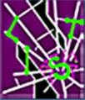


Redefining Web Browser Principals with a Configurable Origin Policy
Yinzhi Cao, Vaibhav Rastogi, Zhichun Li†, Yan Chen and Alexander Moshchuk††
Northwestern Lab for Internet and Security Technology
†NEC Labs America,
††Microsoft Research
Presenter: Yinzhi Cao

Slide 2
Outline
Background and Motivation
  Background (SOP)
  Fine-grained-ness of SOP
  Coarse-grained-ness of SOP
  Origin Spoofing Attacks
Design
Implementation
Evaluation
Conclusion

Slide 3
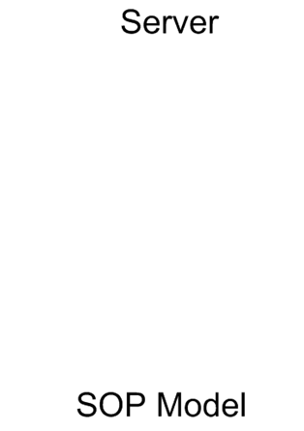

Background
Same-origin policy (SOP).
  An access control policy in a client web browser.
  Scripts/resources with the same triple <scheme, host, port> can access each other.
  SOP is used to define protection boundaries between different web applications.
  SOP is good, but …
malicious.com
benign.com
Principal
One
Principal
Two

Slide 4
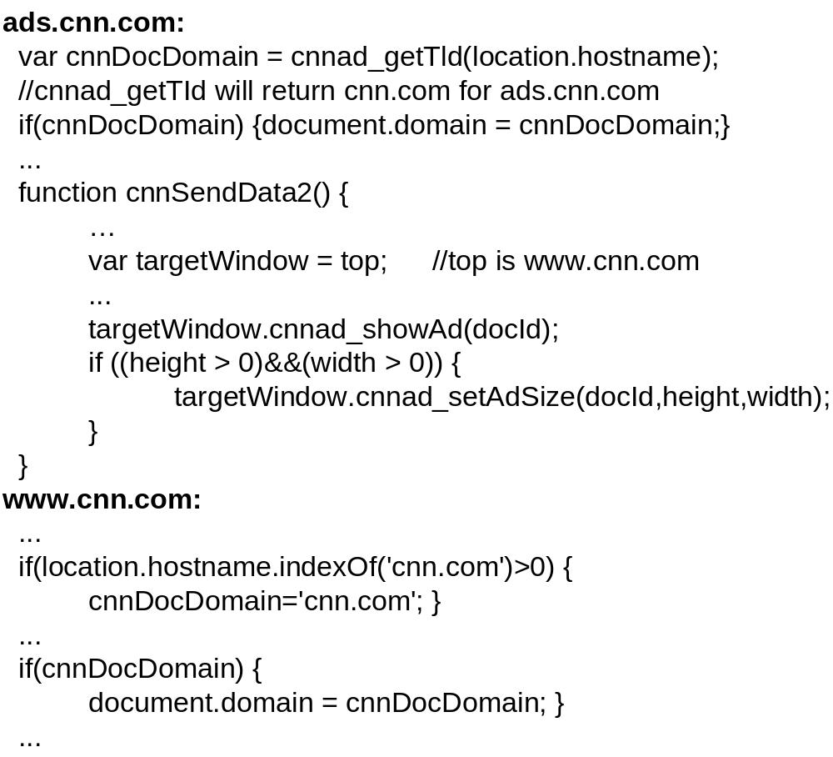
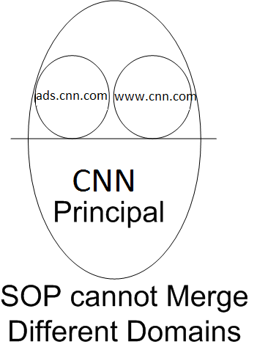
Fine-grained-ness of SOP
Cooperation between Multiple Origins. (SOP cannot)
Thus, some solutions are created.
  document.domain.
  Cross-principal Communication Channel.
  Cross-Origin AJAX.
  ObjectView.
However, Singh et al. show that document.domain can be insecure in Oakland 2010 Paper.

Slide 5
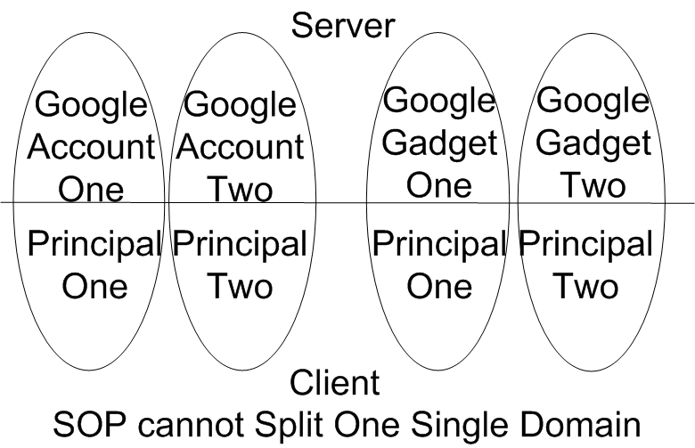
Coarse-grained-ness of SOP
Isolating Content from One Single Domain. (SOP cannot)
  Different Web Sessions at One Client.
  Mashup Isolation.
Existing Solutions
  Private browsing
  SessionStorage
  MashupOS
  OMash
  SMash
  Subspace

Slide 6
Existing approaches can split and merge two SOP defined principals.
However,
there is no new label for those newly created principals, leading to origin spoofing attacks.

Slide 7
Origin Spoofing Attack I
Revisit reply attack proposed by Barth et al.
source.origin.postMessage(replyMsg, origin)
top.postMessage(msg,targetOrigin)
www.igoogle.com
http://googleusercontent.com/attacker
redirect
http://googleusercontent.com/gadget
http://googleusercontent.com/attacker
In SOP, those two gadgets share the same targetOrigin

Slide 8

Origin Spoofing Attack II
Is it malicious.com or connect.com?
Merged Principal
Benign.com
Malicious.com
Connect.com
Request through Cross-origin Resource Sharing

Slide 9
Outline
Background and Motivation
Design
  Several Concepts.
  Configurable Origin Policy.
  Operations on COP origins.
    Create a Principal.
    Join an Existing Principal.
    Communication inside a Principal.
    Communication between Principals.
    Destroy a Principal.
Implementation
Evaluation
Conclusion

Slide 10
Several Concepts
Principal – An abstract container that includes certain resources from both clients and servers with particular properties.
Origin – A label of principal.
OriginID – A physical representation of the origin of a principal.
  Three preserved originID: empty, default, and secret.
PrincipalD – Public version of originID.
Principal’s Server List (PSL) - a list maintained by the browser to record all the servers or part of them that are involved in current principal

Slide 11
Configurable Origin Policy
A COP principal (both server and client parts included) can configure any of its resources to an arbitrary but unique origin.
On the server side, we change the content-to-principal mapping.

Slide 12
SOP:
Server
a.com
b.com
c.com
Principal One
Principal Two
Principal Three
Client
COP:
Server
a.com
b.com
c.com
d.com
originID=1
originID=1
originID=2
originID=3
originID=4
Principal One
Principal Two
Principal Three
Principal Four
Client

Slide 13
Configurable Origin Policy
On the client side, we give the client principal more freedom. Because of the invisibility of our origin to other principals, we can set an arbitrary origin at the client side.

Slide 14
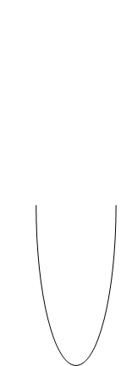
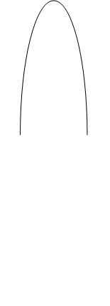






Operation: Create a Principal
Creation of Principal from Scratch
  This will help open different Gmail accounts.
  The server will send different originIDs to the client for different Gmail sessions.
gmail.com
with empty
originID
PSL:gmail.com

Slide 15
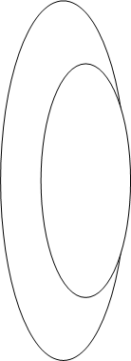
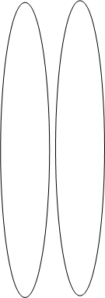






Operation: Create a Principal
Creation of Principal from Another Principal
  Mashup isolation problem can also be solved here.
  Web integrators at client side can create different principals for contents from different third parties by giving different originIDs.
and PSL
and PSL
and the same PSL

Slide 16

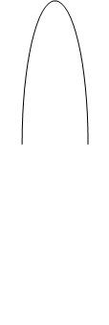
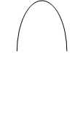
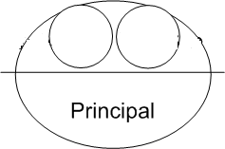
Operation: Request Another Website to Join Its Principal
www.cnn.com
originID & PSL
Contents with the same OriginID and path
PSL:http://www.cnn.com;http://ads.cnn.com
www.cnn.com
ads.cnn.com
ads.cnn.com

Slide 17
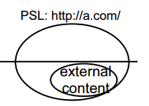
Operation: Join without revealing originID
Used for supplying cacheable contents
Secret originID & PSL
default originID
a.com
Case One
b.com
Case Two
Reject

Slide 18

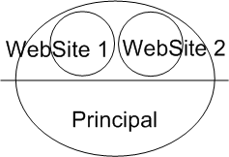
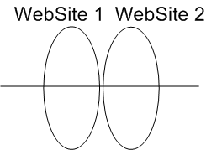
Operation: Join Another Website’s Principal
This case may be useful for collaboration amongst websites. A Facebook principal at the client browser wants to share information with another website, say Yelp.
This Facebook principal will create a new principal which is used for sharing and then gives the originID to Yelp.
Yelp can join that principal with the originID.
WebSite 1
WebSite 2
WebSite 1
WebSite 2
Case One
Yes,
send originID
WebSite 1
WebSite 2
Can I join?
Case Two
No.

Slide 19
Outline
Background and Motivation
Design
Implementation
Evaluation
Conclusion

Slide 20
Enforcing COP: Defining a Principal
Access control methods or other isolation mechanisms are needed to make the boundary of a principal clear.
bool SecurityOrigin::canAccess(const SecurityOrigin* other) const {
…
if (m_protocol == other->m_protocol) {
if (!m_domainWasSetInDOM && !other->m_domainWasSetInDOM) {
if (m_host == other->m_host && m_port == other->m_port)
return true;
} else if (m_domainWasSetInDOM && other->m_domainWasSetInDOM) {
if (m_domain == other->m_domain)
return true;
}
}
}
bool SecurityOrigin::canAccess(const SecurityOrigin* other) const {
if (m_originID!="" || other->originID()!="") {
return m_originID == other->originID();
}
else {
SOP Access Control
}
}
Access Control in COP
Access Control in SOP

Slide 21
Outline
Background and Motivation
Design
Implementation
Evaluation
  Deployment
  Performance
Conclusion

Slide 22
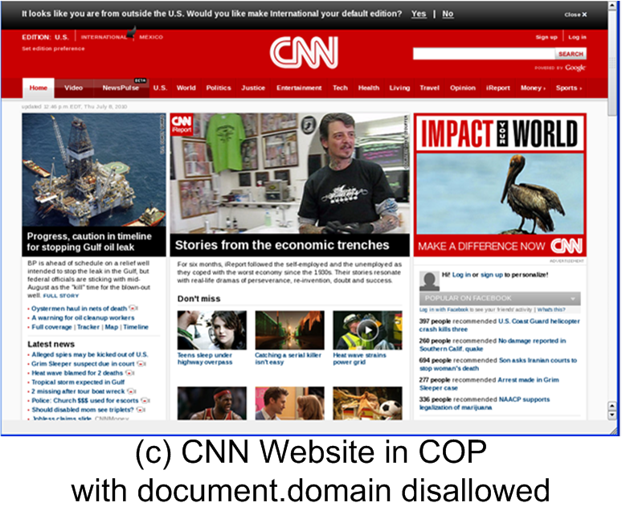
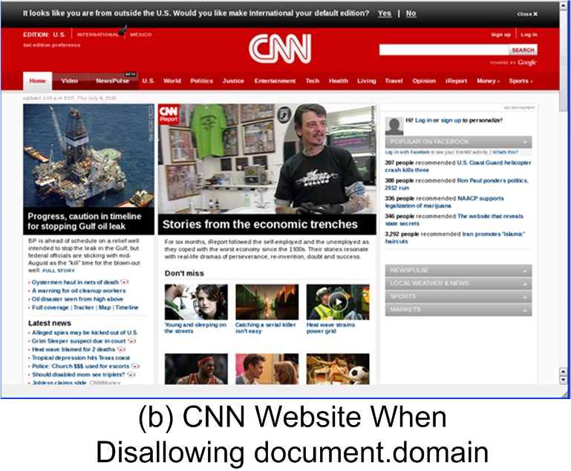
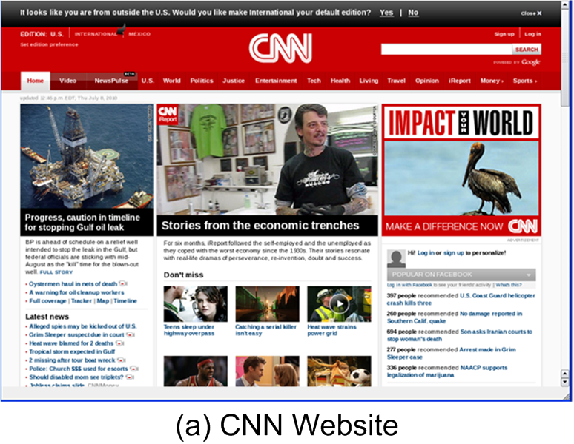
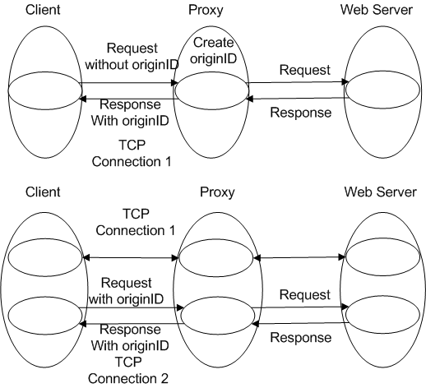
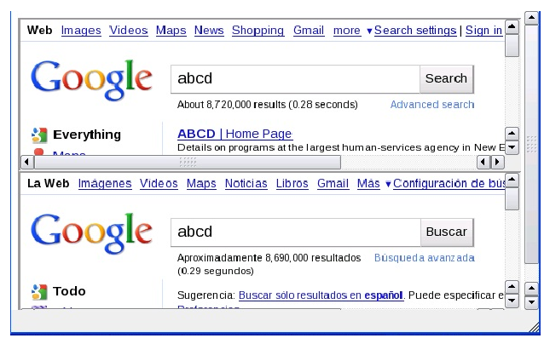
Using Proxy Assistance
Proxy Assitance.
CNN.com.
Different Google Session.

Slide 23
Origin Spoofing Attack I
source.origin.postMessage(replyMsg, PrincipalID)
top.postMessage(msg,PrincipalID)
www.igoogle.com
http://googleusercontent.com/attacker
redirect
http://googleusercontent.com/gadget
http://googleusercontent.com/attacker
In COP, those two gadgets have different OriginID and PrincipalID.

Slide 24
Origin Spoofing Attack II
PSL: http://malicious.com; http://connect.com
Merged Principal
Benign.com
Malicious.com
Connect.com
Request through Cross-origin Resource Sharing

Slide 25
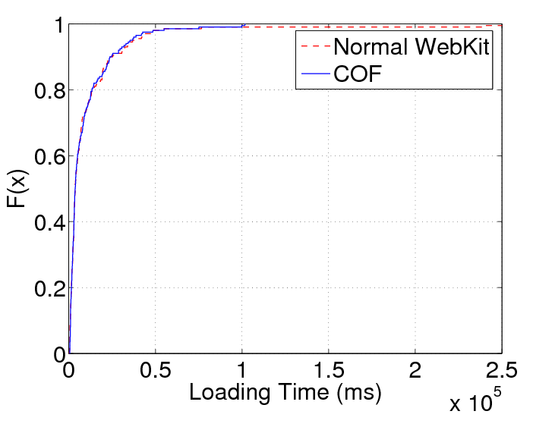
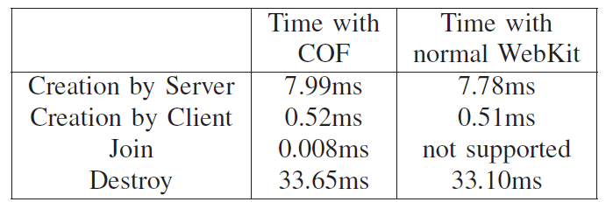
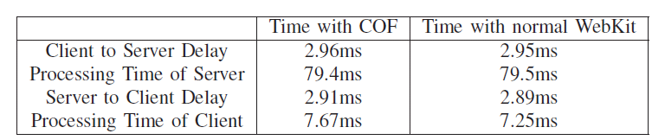
Evaluation
Performance Evaluation
  Loading Time.
  Breakdown of Loading Time.
  Delay of Principal Operations.

Slide 26
Outline
Background and Motivation
Design
Implementation
Evaluation
Conclusion

Slide 27
Conclusion
The browser’s central security policy, same-origin policy (SOP), is questioned.
We propose a new framework, which uses configurable origins that can be dynamically changed by the web server and its client side program.
COP has negligible overhead and is easy to deploy.
More details can be found at http://list.cs.northwestern.edu/WebSecurity

Slide 28
Thank you!

Slide 29
BACKUP

Slide 30
Association of OriginIDs with Resources
Origins for Resources from Servers.
  HTTP Request.
    Communication inside the current principal (a request to a server in PSL): launched from the current principal with its originID.
    Join operation (a request to a server NOT in PSL): launched from the current principal with its originID and PSL
    Create Operation: launched from a different principal with that principal’s originID (usually empty).
  HTTP Response.
    Empty originID in the request.
      Create an oringinID
    Non-empty originID in the request.
      Check and decide whether to join the principal.
Origins for Dynamically-Generated Resources.
<script type="text/JavaScript">
//Inheritance--create an iframe with the same originID
my_iframe1=document.createElement("iframe");
document.getElementById("my_div").appendChild(my_iframe1);
my_iframe1.contentDocument.write("....");
//Dynamic Generation--create an iframe with a different originID my_iframe2=document.createElement("iframe");
document.getElementById("my_div").appendChild(my_iframe2);
my_iframe2.contentDocument.write("....");
my_iframe2.contentDocument.originID = generateOriginID();
</script>
<div id="my_div"> </div>
HTTP/1.1 200 OK
Date: *******
Content-Type: text/html
…
originID: *********
<iframe style=”float:left” originID=”******”>
</iframe>
<script src=”” originID=”******”></script>
OriginID with HTML
OriginID with HTTP

Slide 31
Discussion on Compatibility
Compatibility with Existing Servers.
  SOP is a special case of COP.
Compatibility with Existing Client Browsers.
  We convey originID in a protocol field not recognizing which older browsers will ignore.

Slide 32





document.domain
Singh et al. show that document.domain can be insecure.
Original: y.a.com
Original: a.com
Effective: a.com
Effective: a.com
(1) 1.html changes its domain.
(2) 3.html changes its domain.
3.html
(3) 3.html inject script into 1.html.
main.html
Eighteen out of one hundred top Alexa web sites are using document.domain.
(4) Script reads cookies from 2.html.
(5) 1.html passes cookies to 3.html.
1.html
2.html
Original: x.a.com
Original: x.a.com
Effective: a.com
Effective: x.a.com
Figure is from SINGH, K., MOSHCHUK, A., WANG, H., AND LEE, W. On the Incoherencies in Web Browser Access Control Policies. In 31st IEEE Symposium on Security and Privacy (Oakland) (2010).

Slide 33
Cross-Origin AJAX
Since AJAX requests obey SOP, the client’s browser cannot request a URL through XMLHTTPRequest from a different origin.
Many proposals have been made in this regard.
  Cross-origin resource sharing. http://www.w3.org/TR/access-control/#origin
  IETF Draft about HTTP Origin. http://tools.ietf.org/html/draft-abarth-origin-00#section-6
  XDomainRequest in IE8. http://msdn.microsoft.com/en-us/library/dd573303%28VS.85%29.aspx

Slide 34
Summary for Fine-grained-ness of SOP
Overall, all these problems exist because the same origin policy restricts cross-domain access.
We aim to make cooperation between multiple origins easier and less error-prone.
We will disallow document.domain and uses a configurable origin protocol to combine multiple SOP origins into one configurable origin.

Slide 35
Summary for Coarse-grained-ness of SOP
SOP is sometimes too coarse for finer-grained origins. Many existing works have shown and solved the problem. We are going to design a big framework that can also solve the problem.
Moreover, existing works cannot solve the combination of splitting and merging.
For example, one Mashup from a.com may want to merge with another Mashup from b.com.

Slide 36
This join operation can be used in document.domain examples.
For example, previously, www.cnn.com and ads.cnn.com both change document.domain = “cnn.com”
Now, www.cnn.com principal at client side sends a request to ads.cnn.com with the principal’s originID.
ads.cnn.com will agree to join the existing principal with the same originID.

Slide 37
Other Operations
Communication inside a Principal.
  Not restricted. Accompanied by originID.
Communication between Principals.
  postMessage channel
  Object View (WWW 2010)
Destroy a Principal.
  Use close().

Slide 38
OriginID and PrincipalID Generation
The representation of originID is similar to that of a session cookie.
  We will use the same way of generating a session ID.
PrincipalID is a public representation of originID.
  Once a principal is created, we will assign an arbitrary principalID for it.

Slide 39
Server Modification
We modify the server so that resources in one web session will be allocated into one principal at client.
Categories of Sessions.
  Explicit sessions, also known as login sessions.
    Use session ID or identity cookie as originID.
  Implicit sessions.
    We need to create our own originID.

Slide 40
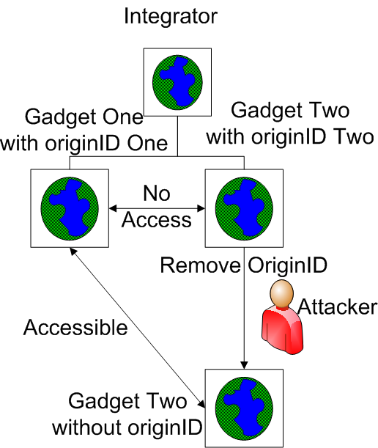
Security Analysis
OriginID Sniffing.
  Use HTTPs.
Mixing of COP and SOP.
  Mixing two principles.
    Always use COP.
  Mixing two sites.
    SOP is a special case of COP.

Slide 41
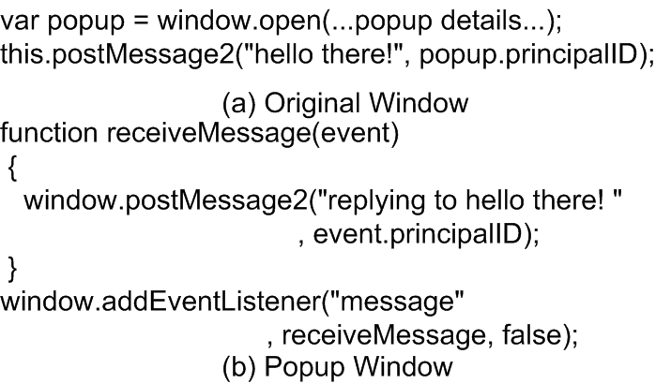
Association of OriginIDs with Communications
Communications between Principals.
  postMessage Channel.

Slide 42
Outline
Background and Motivation
Design
Implementation
Security Analysis
Evaluation
Conclusion

Slide 43
Formal Security Analysis
A formal web security model based on Alloy by Akhawe et al.
We switch same-origin policy to conﬁgurable origin policy in their model.
Alloy is not able to find any counterexample.

Slide 44
Security Analysis
Cross Site Request Forgery (CSRF).
  Step One, the link needs to be imbedded in the website.
  Step Two, the browser needs to send the request.
  Step Three, the server (the bank in this case) needs to allow this action.
In COP, the server will see the request is from different principal and thus reject it (Step Three).
<img src=http://bank.com/transfer.do?acct=A&amount=10 width="1" height="1" border="0">

