Slide 1
JShield: Towards Real-time and Vulnerability-based Detection of Polluted Drive-by Download Attacks
Yinzhi Cao*, Xiang Pan**, Yan Chen** and Jianwei Zhuge***
* Columbia University
** Northwestern University
*** Tsinghua University

Slide 2
Outline
Introduction, Background and Overview
Motivation
Design
Evaluation
Conclusion

Slide 3
Introduction and Background
Drive-by download Attack
  Unintended download of malicious computer software from the Internet, which is usually due to a browser vulnerability, such as buffer and heap overflow.
Approximately 1.3% of the incoming search queries (millions per day) to Google returned at least one URL with a drive-by download attack.

Slide 4
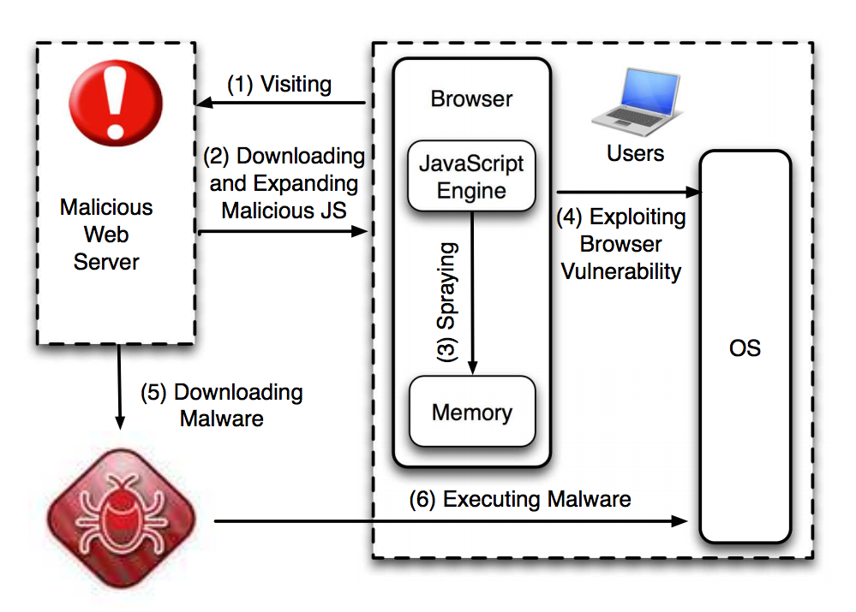

Slide 5
Overview
  A reactive vulnerability-based approach to match malicious JavaScript samples targeting drive-by download attacks.
  JShield (> 4,000 additional lines of code integrated into WebKit) has been adopted by Huawei, the world’s largest telecommunication equipment maker.
  I spent two months at Huawei in 2012 and 2013 respectively to help them test JShield with millions of real-world samples.
  JShield is filed under a U.S. patent (14/207,665).

Slide 6
Deployment
Server Side
  The Web Application Firewalls (WAF) or Web IDS/IPS
  Web malware scanning services
Client Side
  Part of Anti-virus Software

Slide 7
Outline
Introduction, Background and Overview
Motivation
Design
Evaluation
Conclusion

Slide 8
Motivation
Attackers will change existing malicious JavaScript code to evade detection, called sample pollution:
  Embedded inside DOM events, such as mouse moves.
  Injected and interleaved with benign JavaScript code.

Slide 9
Motivation Cont’d
Top Vendors in Industry:
Anti-virus Software | Original Samples | Polluted Samples
Avira Antivirus Premium 2013 | 98.00% (1176/1200) | 0.58% (7/1200)
AVG Internet Security 2013 | 89.33% (1072/1200) | 3.58% (43/1200)
Kaspersky Internet Security 2012 | 92.41% (1109/1200) | 2.00% (24/1200)
Norton Internet Security 2013 | 20.67% (248/1200) | 0.08% (1/1200)
Trend Micro Titanium Internet Security 2013 | 87.58% (1051/1200) | 2.00% (24/1200)

Slide 10
Motivation Cont’d
State-of-the-art Research Work:
Detection Rate of Zozzle [1]
 | Original Samples | Polluted Samples
True Positive | 93.1% | 36.7%
False Positive | 0.5% | 0.5%
[1] Curtsinger, Charlie, Benjamin Livshits, Benjamin G. Zorn, and Christian Seifert. "ZOZZLE: Fast and Precise In-Browser JavaScript Malware Detection." In USENIX Security Symposium, pp. 33-48. 2011.

Slide 11
Outline
Introduction, Background and Overview
Motivation
Design
Evaluation
Conclusion

Slide 12
Solution Space
High
Turing Machine Signature
JShield Signature
Ideal Signature
Accuracy
Symbolic Constraint Signature
Regular Expression
Low
Speed
High

Slide 13
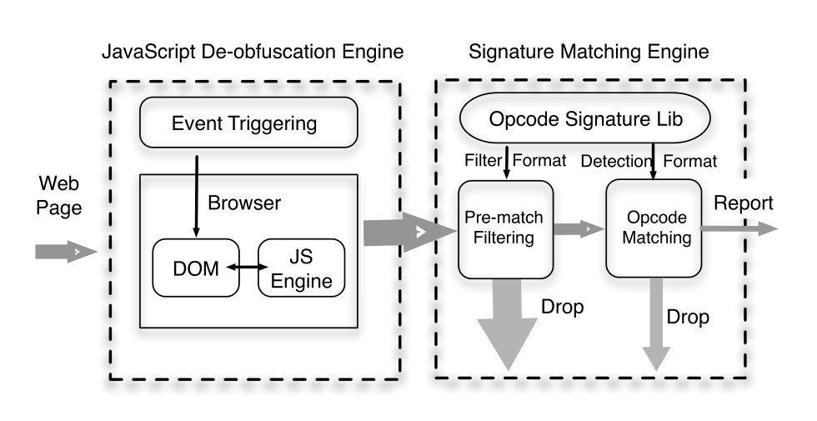
System Architecture

Slide 14
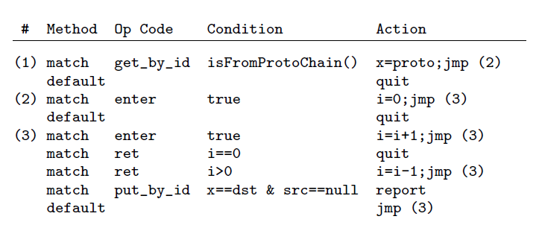
Opcode Signature Example
Signature
Sentence
Clause

Slide 15
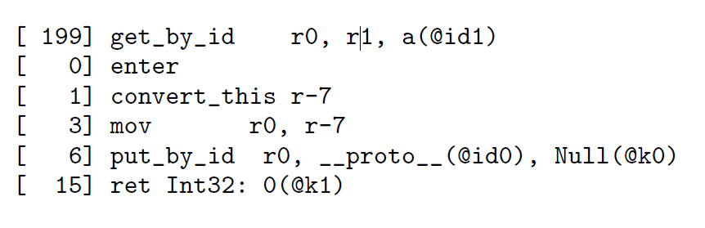
Example
Exploit:
var obj = new Object();
obj.__proto__.__defineGetter__("a", function () {
this.__proto__ = null;
return 0;
});
obj.a;
Outputted Opcodes:

Slide 16
Matching Process
Opcodes of the exploit:
Signature to be matched:
State 1
State 2
State 3

Slide 17
Outline
Introduction, Background and Overview
Motivation
Design
Evaluation
Conclusion

Slide 18
Evaluation
Vulnerability Coverage Rate
Robust to Sample Pollution
Performance

Slide 19
Evaluation
Vulnerability Coverage
Vulnerability Position | BrowserShield | Song et al. | JShield
JS Engine | 3/22 | 0/22 | 22/22
PDF JS Engine | 4/18 | 0/18 | 18/18
Plug-in | 20/21 | 21/21 | 21/21
Reis et al., Browsershield: vulnerability-driven filtering of dynamic html. In OSDI (2006).
Song et al., preventing drive-by download via inter-module communication monitoring. In ASIACCS (2010).

Slide 20
Evaluation
Accuracy
 | Original Samples | Polluted Samples
TP for Web Pages | 100% | 100%
FP for Web Pages | 0% | 0%
Anti-virus Software | Original Samples | Polluted Samples
Avira Antivirus Premium 2013 | 98.00% (1176/1200) | 0.58% (7/1200)
AVG Internet Security 2013 | 89.33% (1072/1200) | 3.58% (43/1200)
Kaspersky Internet Security 2012 | 92.41% (1109/1200) | 2.00% (24/1200)
Norton Internet Security 2013 | 20.67% (248/1200) | 0.08% (1/1200)
Trend Micro Titanium Internet Security 2013 | 87.58% (1051/1200) | 2.00% (24/1200)
Zozzle | Original Samples | Polluted Samples
True Positive | 93.1% | 36.7%
False Positive | 0.5% | 0.5%

Slide 21
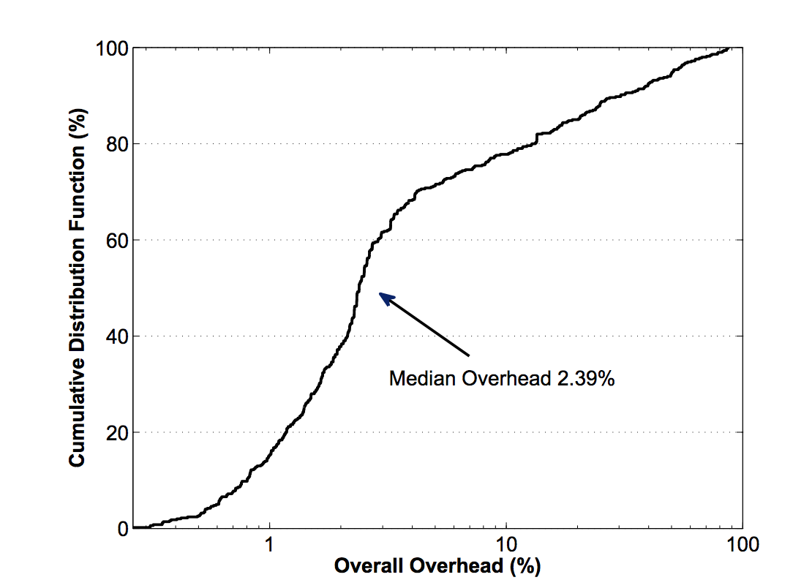
Evaluation
Performance

Slide 22
Outline
Introduction, Background and Overview
Motivation
Design
Evaluation
Conclusion

Slide 23
Conclusion
In this talk, I presented JShield, a vulnerability based detection engine of drive-by download attacks.
JShield represents the semantics of each vulnerability and is robust to sample pollution.
In evaluation, we show that JShield incurs affordable overhead.

Slide 24
Thank you!
Questions?
yzcao@cs.columbia.edu
http://www.yinzhicao.org

