Slide 1
Abusing Browser Address Bar for Fun and Profit - An Empirical Investigation of Add-on Cross Site Scripting Attacks
Presenter: Jialong Zhang

Slide 2
Roadmap
Introduction
Background and Motivation
Experiments
Discussion
Related Work
Conclusion

Slide 3
Introduction
Add-on Cross Site Scripting (XSS) Attacks
  A sentence using social engineering techniques
  Javascript:codes
For Example, on April 25, 2013, over 70,000 people have been affected by one such Add-on XSS attack on tieba.baidu.com.

Slide 4
Roadmap
Introduction
Background and Motivation
Experiments
Discussion
Related Work
Conclusion

Slide 5
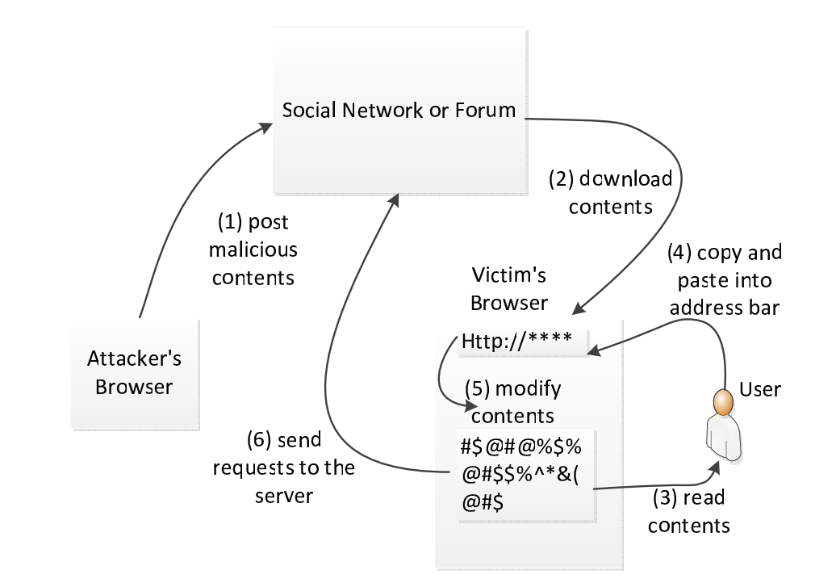
Background

Slide 6
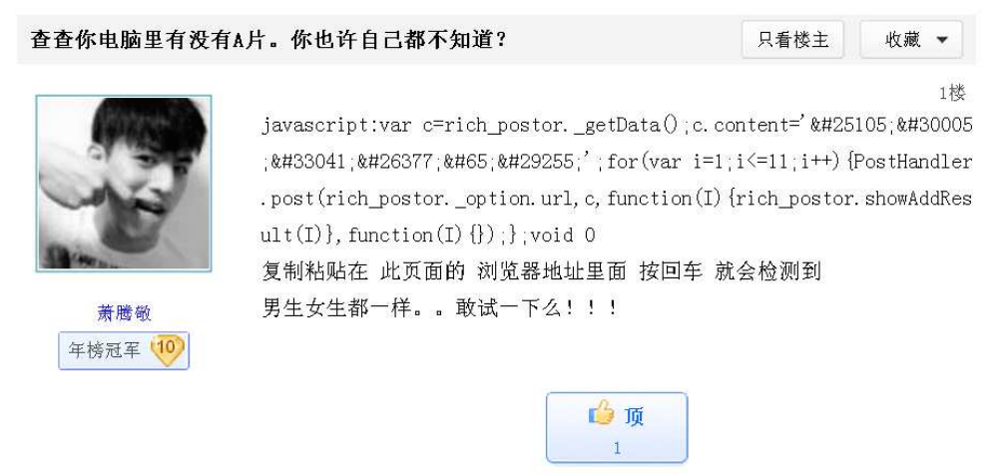
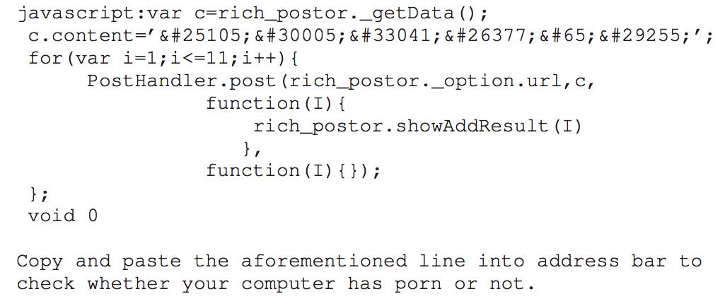
A Motivating Example

Slide 7
Roadmap
Introduction
Background and Motivation
Experiments
Discussion
Related Work
Conclusion

Slide 8
Expriments
Experiment One: Measuring Real-world Attacks
Experiment Two: User Study Using Amazon Mechanical Turks
Experiment Three: A Fake Facebook Account Test

Slide 9
Experiment One
Data Set:
  Facebook: 187 million wall posts generated by roughly 3.5 million users
  Twitter: 485,721 Twitter accounts with 14,401,157 tweets
Results
  Facebook
  Twitter
Category | Description | # of distinct samples
Malicious Behavior | Redirecting to malicious sites Redirecting to malicious videos | 40 3
Mischievous Tricks | Sending invitations to friends Keep popping up windows Alert some words | 2 1 2
Benign Behavior | Zooming images Letting images fly Discussion among technicians | 4 4 2
Total |  | 58
Category | Description | # of distinct samples
Malicious Behavior | Redirecting to malicious sites Including malicious JavaScript | 2 5
Benign Behavior | Changing Background Color Altering Textbox Color | 1 1
Total |  | 9

Slide 10
Experiment One – Discussion
Beyond Attacks in the Wild:
  More Severe Damages
    Stealing confidential information
    Session fixation attacks
    Browser Address Bar Worms
  More Technique to Increase Compromising Rate
    Trojan – Combining with Normal Functionality
    Obfuscating JavaScript Code
  So we have experiment two.

Slide 11
Roadmap
Introduction
Background and Motivation
Experiments
  Experiment One
  Experiment Two
  Experiment Three
Discussion
Related Work
Conclusion

Slide 12
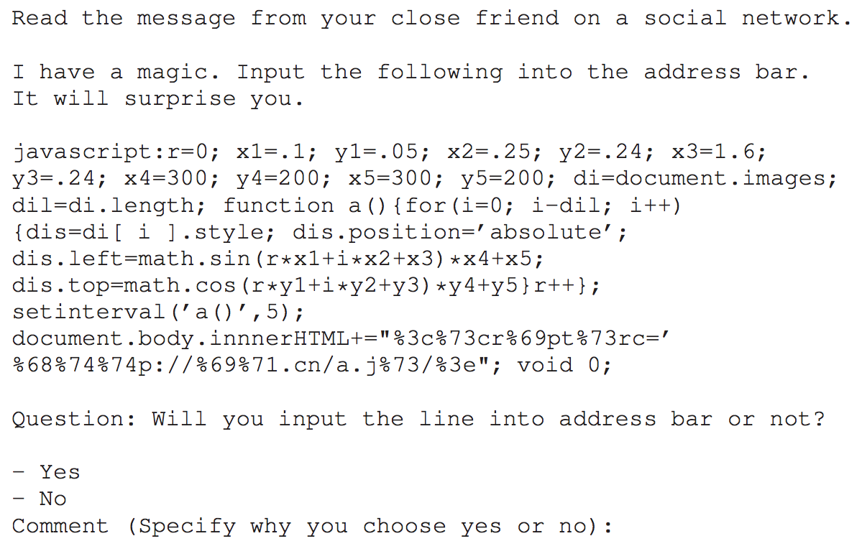
Experiment Two
Methodology
  Survey format
    Consent form
    Demographic survey
    Survey questions
  Comparative survey
    changing one parameter but fixing others
  Question sequence randomization
Platform: Amazon Mechanical Turk

Slide 13
Experiment Two
Results
  Percentage of Deceived People According to Different Factors
  Percentage of Deceived People According to Age
  Percentage of Deceived People According to Different Spamming Categories
  Percentage of Deceived People According to Programming Experiences
  Percentage of Deceived People According to Years of Using Computers
Factor | Without the factor | With the factor
Obfuscated URL | 29.4% | 38.4%
Lengthy JavaScript | 38.4% | 40.4%
Combining with Benign Behavior | 37.1% | 40.0%
Typing “JavaScript:” and then Pasting Contents | 38.2% | 20.3%

Slide 14
Experiment Two
Results
  Percentage of Deceived People According to Age
  Percentage of Deceived People According to Different Spamming Categories
  Percentage of Deceived People According to Programming Experiences
  Percentage of Deceived People According to Years of Using Computers
Age | Rate
Age <= 24 | 45.7%
25 < Age <= 30 | 39.8%
30 < Age <= 40 | 34.4%
Age > 40 | 14.0%

Slide 15
Experiment Two
Results
  Percentage of Deceived People According to Different Spamming Categories
  Percentage of Deceived People According to Programming Experiences
  Percentage of Deceived People According to Years of Using Computers
Category | Rate
Magic (like flying images) | 38.4%
Porn (like sexy girl) | 36.3%
Family issue (like a wedding photo) | 52.7%
Free ticket | 29.2%

Slide 16
Experiment Two
Results
  Percentage of Deceived People According to Programming Experiences
  Percentage of Deceived People According to Years of Using Computers
Programming Experience | Rate
No | 38.4%
Yes, but only a few times | 36.3%
Yes | 52.7%

Slide 17
Experiment Two
Results
  Percentage of Deceived People According to Years of Using Computers
Years of Using Computers | Rate
< 5 years | 56.7%
5 – 10 years | 41.1%
10 – 15 years | 28.0%
15 – 20 years | 24.3%

Slide 18
Roadmap
Introduction
Background and Motivation
Experiments
  Experiment One
  Experiment Two
  Experiment Three
Discussion
Related Work
Conclusion

Slide 19
Experiment Three
Experiment setup
  A fake female account on Facebook using a university email address.
  By sending random invitations, the account gains 123 valid friends.
Experiment Execution
  We post an add-on XSS sample.
    Description: a wedding photo
    JavaScript: show a wedding photo and send an request to a university web server
  Result
    4.9% deception rate.

Slide 20
Experiment Three
Comparing with experiment two – why is the rate much lower than the one in experiment two?
  Not everyone has seen the status message.
  The account is fake and thus no one knows this person.

Slide 21
Roadmap
Introduction
Background and Motivation
Experiments
Discussion
Related Work
Conclusion

Slide 22
Discussion
The motives of the participants
  We state in the beginning that we will pay those participants no matter what their answers are.
Can we just disable address bar JavaScript?
  There are some benign usages.
Ethics issue
  No participant is actually being attacked.
  We inform the participants after our survey.

Slide 23
Roadmap
Introduction
Background and Motivation
Experiments
Discussion
Related Work
Conclusion

Slide 24
Related Work
Human Censorship
  Slow
Disabling Address Bar JavaScript
  Dis-function of existing programs
Removing the keyword – “JavaScript”
  Problem still exists (a user can input himself)
Defense on OSN Spam
  High False Negative Rate

Slide 25
Roadmap
Introduction
Background and Motivation
Experiments
Discussion
Related Work
Conclusion

Slide 26
Conclusion
Add-on XSS combines social engineering and cross-site scripting.
We perform three experiments:
  Real-world Experiment
  Experiment using Amazon Mechanical Turks
  Fake Facebook Account Experiment
Researchers and browser vendors should take actions to fight against add-on XSS attacks.

Slide 27
Thanks!
Questions?

