Slide 1
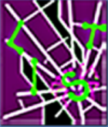

PathCutter: Severing the Self-Propagation Path of XSS JavaScript Worms in Social Web Networks
Yinzhi Cao§, Vinod Yegneswaran†, Phillip Porras†, and Yan Chen§
§Northwestern Lab for Internet and Security Technology, Northwestern University, Evanston, IL
†SRI International, Menlo Park, CA

Slide 2

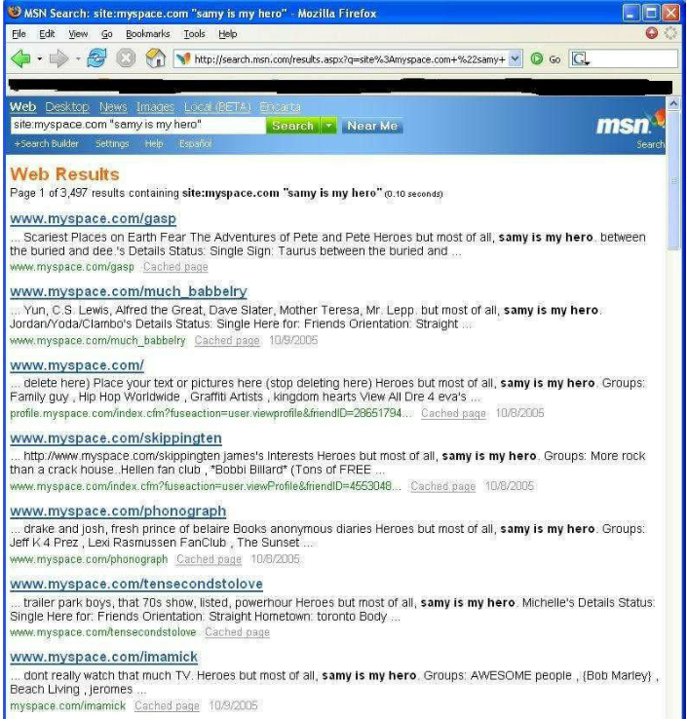
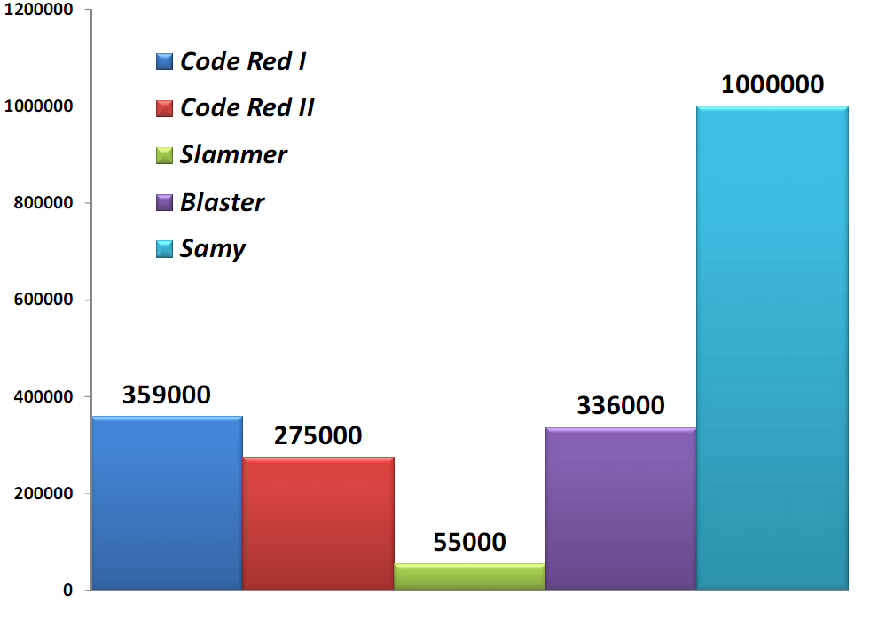
Introduction
Social web networks
  Platforms where people share their perspectives, opinions, thoughts and experiences
  OSNs, Blogs, Social bookmarking etc.
XSS worm threat is severe.
  First worm: MySpace Samy (2005)
  More and more prevalent: Renren, Yamanner, etc.
  Akin to virus: human need to visit infected pages
  Characteristic: Fast spreading
In this paper,
  Target: Prevent XSS worm propagation
  Method: View separation & Request authentication
Number of infected clients after 20 hours (Social Networks’ XSS Worms, Faghani et al.)
Notes:
within just 20 hours in October 4, 2005, the MySpace Samy worm infected more than one million users on the Internet

Slide 3
Roadmap
Introduction
Background
  Attack Steps
  XSS Taxonomy
Related Work
Our Approach
Implementation
Evaluation

Slide 4



Background
Step 1 – Enticement and Exploitation
Step 2 – Privilege Escalation
Step 3 – Replication
Step 4 – Propagation
Samy’s page
Download
Modify benign user’s account
Repeat Process
Other Users
Get infected
Benign User

Slide 5
XSS Taxonomy
XSS Attacks
Server-side XSS
Client-side XSS
Reflected XSS
Plugin XSS
Content
Sniffing
XSS
Stored XSS
DOM-based
XSS
MySpace Samy Worm
Yamanner Worm
Flash XSS
Java XSS
Our Experimental
Worm
Renren Worm
SpaceFlash Worm

Slide 6
Related Work
Group one: Prevent XSS vulnerabilities
  Incomplete coverage (BluePrint, Plug-in Patches, Barth et al., and Saxena et al.)
Group two: Prevent XSS worms
  No early-stage prevention (Spectator and Xu et al.)
  Not resistant to polymorphic worm (Sun et al.)
Our goal: Prevent all the XSS worms with early-stage prevention and resistance to polymorphic worms

Slide 7

Our Approach
Two key concepts: (1) request authentication and (2) view separation
We use request authentication.
Download
Modify benign user’s account
View separation is always enforced.
Access
Samy’s page
Benign User

Slide 8
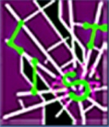
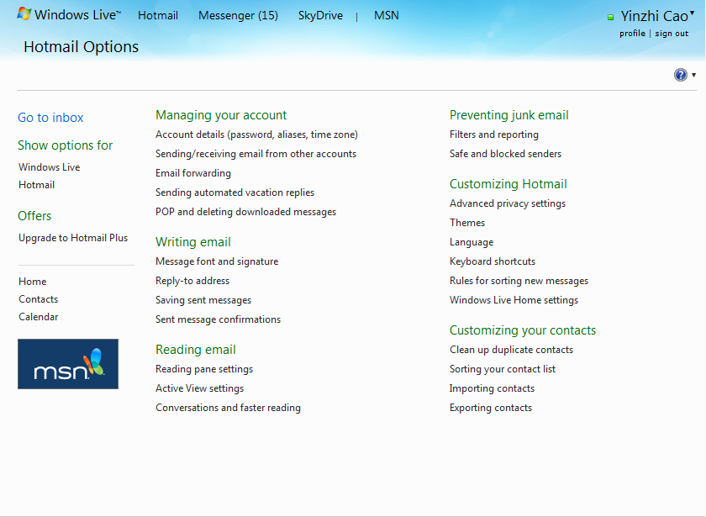
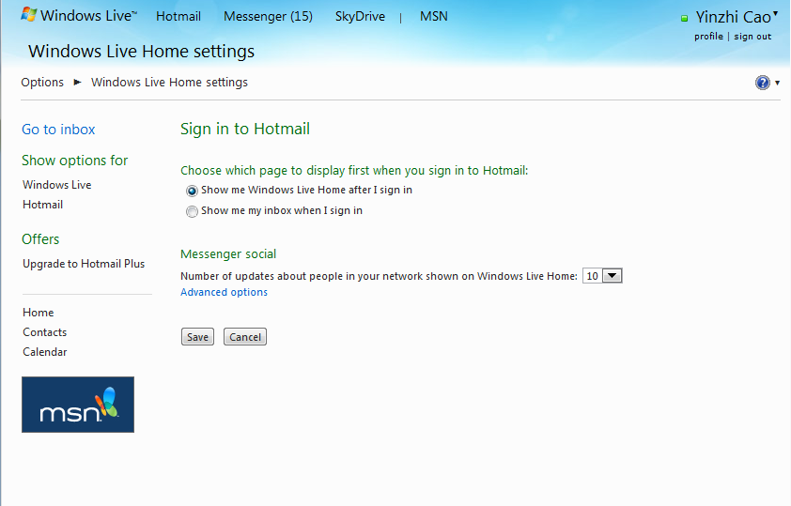
View Separation
For example, blog A, blog B, blog C and so on.
Or more fine-grained, different pages in the same blog.
Isolating contents from the same origin
  iframe tag with sandbox properties in HTML5
  Pseudodomain encapsulation (mentioned later)
View One
View Two

Slide 9
Request Authentication
For example, requests from blog A does not have permissions to modify blog B
Identifying which view a client-side request is from.
  Secret token
  Referer header
Check if the view has the permission

Slide 10
Our Approach
View one does not have the permission.
Identify that it is from View One. If we cannot identify, deny.
Download
Modify benign user’s account
Isolating views at client side.
Access
View One
View Two
Benign User

Slide 11
Roadmap
Introduction
Background
Related Work
Our Approach
Implementation
  Implementation One (Server Modification)
  Implementation Two (Proxy)
Evaluation
  Case Study of Five Real-world Worms and Two Experimental Worms (only two covered in the talk)
  Performance

Slide 12
Implementation One (Server Modification)
Prototype examples: WordPress, Elgg
Dividing views: by blogs
Permissions for different views: can only modify its own blog.

Slide 13
View Isolation for Server Modification
It cannot break isolate.x.com (different origin).
Isolating views at client side.
  Pseudodomain encapsulation.
isolate.x.com
isolate.x.com
content.x.com
content.x.com
attacker
Secret token is required.
content.x.com

Slide 14
Request Authentication for Server Modification
Identifying requests from client-side
  Secret token
    Insertion position: Each request that will modify server-side contents.
Checking requests’ permission
  Checking position: Database operation. (A narrow interface that each modifying request will go through.)

Slide 15
Implementation Two (Proxy)
Dividing views: by different client-side URLs.
Permissions for different views:
  Possible outgoing post URL from those URLs

Slide 16

View Isolation for Proxy
Isolating views at client side
  The same as implementation one.
Web Server
Proxy
isolate.x.com
isolate.x.com
Redirect to
isolate.x.com
<iframe src = “content.x.com/y.php?token = ***
content.x.com
Request content.x.com/y.php

Slide 17
Request Authentication for Proxy
Identifying requests from client-side
  Referer header
    Specified by the browser. Attackers cannot change it.
Checking requests’ permissions
  Checking position: Proxy.
  Method: See if the view has the permission to send the request.

Slide 18


Case Study for Real World Worms
XSS Worm in Renren (Facebook in China)
Flash
insert malicious scripts inside the web page
Share on the behalf of current user

Slide 19
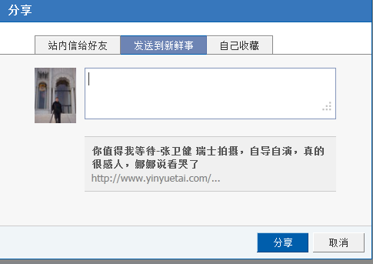
View One
share
View Two
click
Request to share

Slide 20
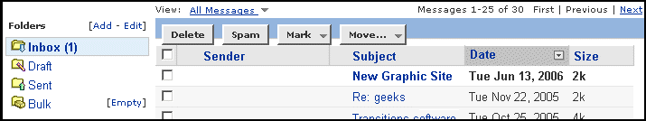
Yamanner Worm
Click
Send emails to all your contacts

Slide 21
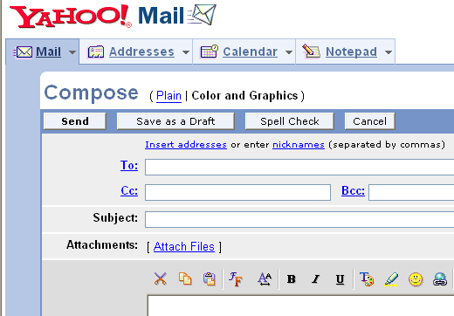
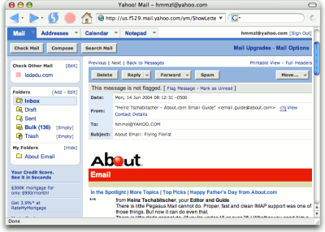
Compose email
Different views
Email body
Send email

Slide 22
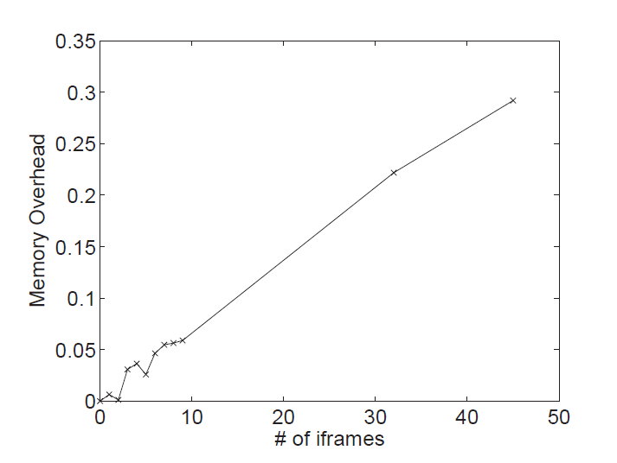
Evaluation
Memory Overhead
  Normally, # of frames is not high since comments can be hidden.
Rendering Time Overhead.
  Less than 3.5% for Elgg

Slide 23
Conclusions
We cut off the propagation path of XSS worms through view separation by psuedodomain encapsulation and request authentication.
We implement PathCutter by proxy assistance and server modification.
We evaluate PathCutter on 5 real-world worms and 2 proof-of-concept worms.

Slide 24
Thanks!
Questions?

Slide 25
Backup

Slide 26
Comparison with Existing Works
Group Two: Worm prevention
Group One: Mitigating XSS
 | Spectator | Sun et al. | Xu et al. | BluePrint | Plug-in Patches | Barth et al. | Saxena et al. | PathCutter
Blocking Step | 4 | 3 | 4 | 1 | 1 | 1 | 1 | 2
Polymorphic Worm | Yes | No | Yes | Yes | Yes | Yes | Yes | Yes
Early-Stage Prevention | No | Yes | No | Yes | Yes | Yes | Yes | Yes
Types of XSS that Can Be Defended | All | All | Passively Observable Worms | Traditional Server-side XSS Worms | Plug-in XSS Worms | Content Sniffing XSS Worms | DOM-Based XSS Worms | All
Deployment | Server or Proxy | Client | Server | Server | Client | Client | Client | Server or Proxy
Passive/Active Monitoring | Active | Passive | Passive | Active | Active | Active | Active | Active

Slide 27
Limitation
Need to know the semantics of web application
Only prevent worm behavior but not all the damages

Slide 28
Existing solutions
Spectator
But it can only detect the worm when it spreads for a while!
proxy
… if it reaches a threshold, report it.
the same injected tag
the same injected tag

Slide 29

Existing solutions
Esorics 09
But
(1) Payload may change.
(2) Pure client-side solution.
The same payload
Deny!
Firefox Plugin
Payload: abcdefg
Payload: abcdefg
malicious
benign

Slide 30
  URL graph provided by the server or a third-party
blogX/post-comment.php
blogX/index.php
blogX/options.php
blogX/update-options.php
…
blogX/x.php
blogY/index.php

