Slide 1
Virtual Browser: a Virtualized Browser to Sandbox Third-party JavaScripts with Enhanced Security
Yinzhi Cao, Zhichun Li*, Vaibhav Rastogi, Yan Chen, and Xitao Wen
Labs of Internet Security and Technology
Northwestern University
*NEC Labs America

Slide 2
Outline
Introduction
Related Work
Design
Security Analysis
Evaluation
Conclusions

Slide 3
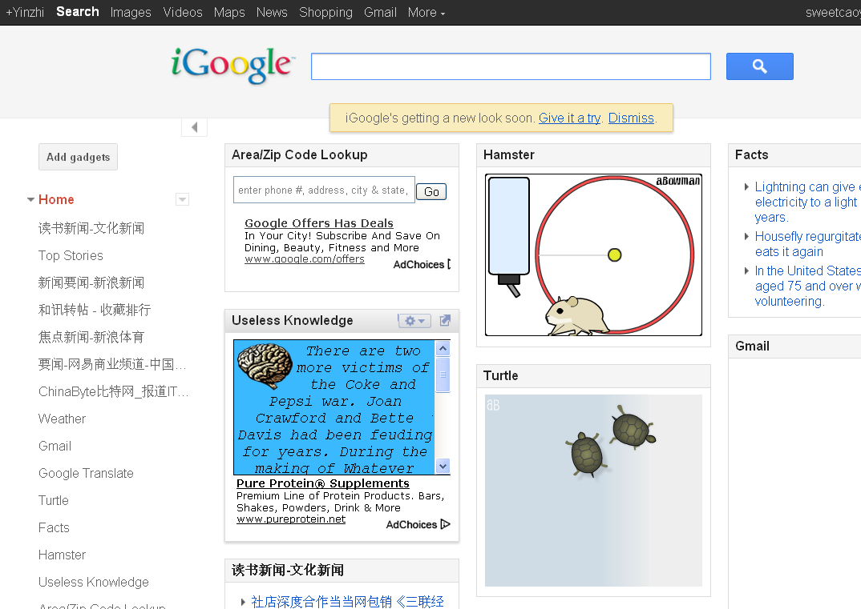

Introduction
Third-party JavaScripts are popular.
  Web Mashups
  Third-party Games
  Widgets
  Visitor Counters
However, they share the same privilege as host web site, and thus
  They can sabotage host web site.
  They can exploit client browsers.
So we propose: Virtual Browser, a virtualized browser built upon native browsers.

Slide 4
Outline
Introduction
Related Work
Design
Security Analysis
Evaluation
Conclusions

Slide 5
Related Work
JavaScript level approaches
  Static methods (ADSafe, FBJS, CoreScript, and Maffeis et al.)
  Runtime Approaches (Microsoft Web Sandbox, and Google Caja)
  Mixed Approaches (GateKeeper, Huang et al.)
Native approaches
  Browser modification (ConScript, MashupOS and WebJail)
  Approaches using NaCl (AdSentry)
  Approaches using iframes (AdJail and SMash)

Slide 6
JavaScript level approaches
No dynamic JavaScript feature support (eval and with)
Vulnerable to drive-by-download (especially unknown attacks)
Vulnerable to browser quirks
  Undocumented HTML/JavaScript parsing behavior such as <scri\npt> is parsed as <script>

Slide 7
Native approaches
Modification to browsers.
Many are vulnerable to drive-by-download attacks.

Slide 8
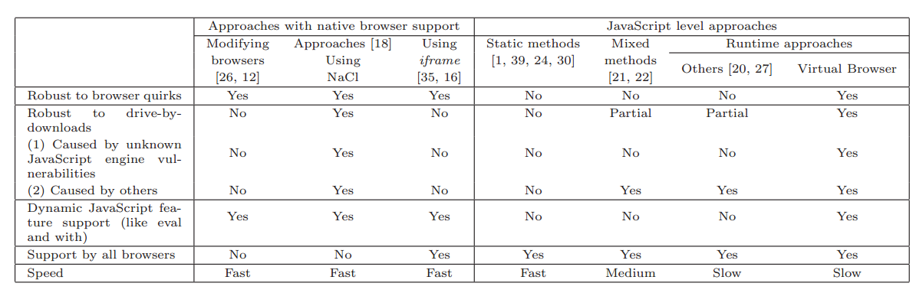
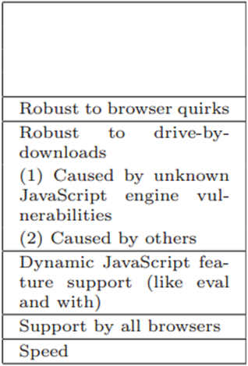

Slide 10
Therefore we propose:
An approach that is (your take-away)
  Robust to drive-by-download
  Support dynamic JavaScript features
  Supported by all the browsers
  Robust to browser quirks
Virtual Browser

Slide 11
Outline
Introduction
Related Work
Design
Security Analysis
Evaluation
Conclusions

Slide 12
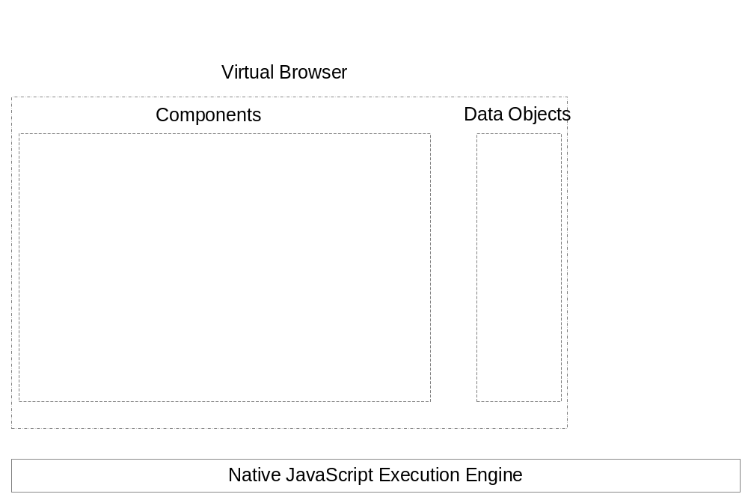
System Architecture

Slide 13
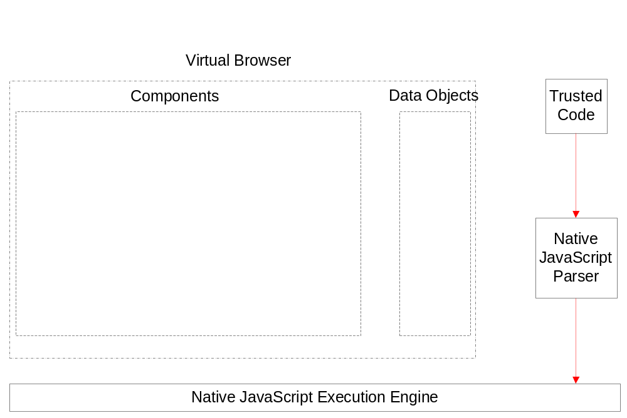
System Architecture

Slide 14
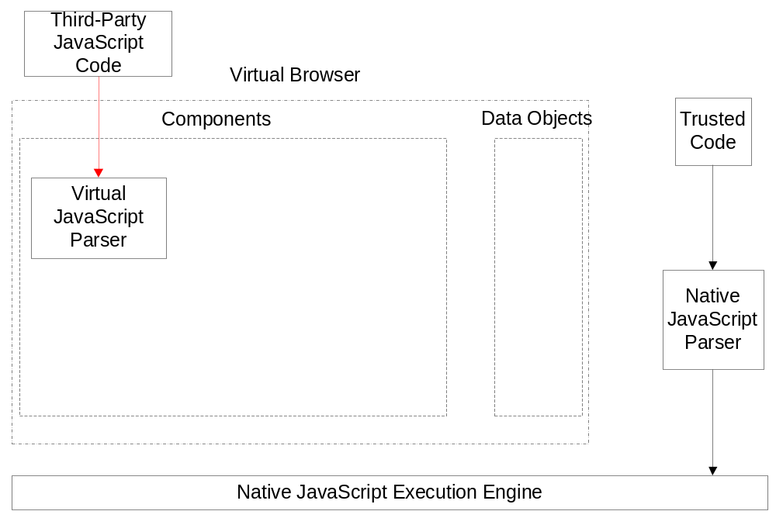
System Architecture
Only one parser: mitigating quirks

Slide 15
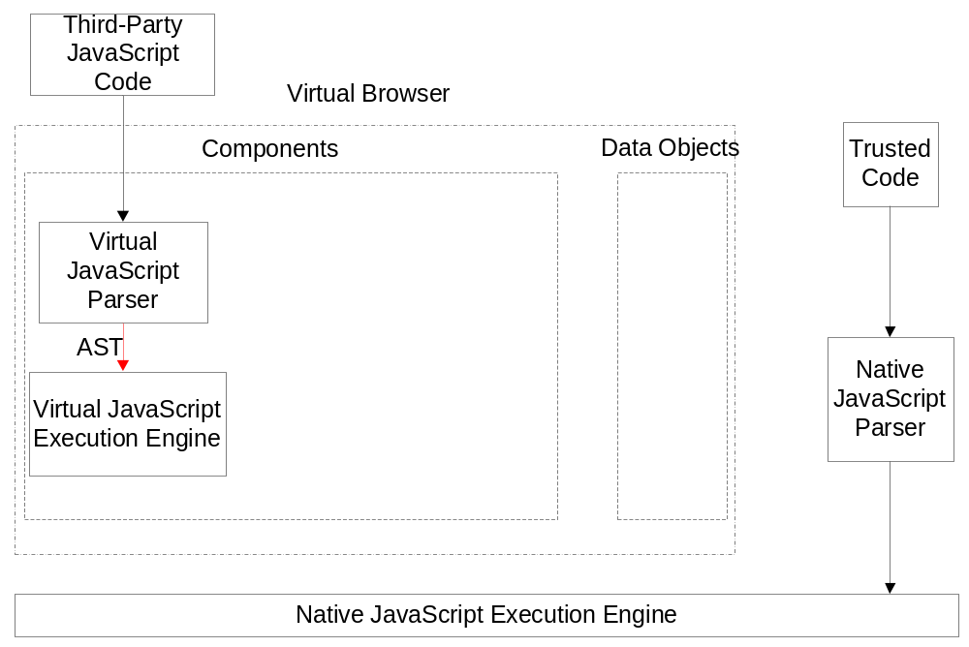
System Architecture

Slide 16
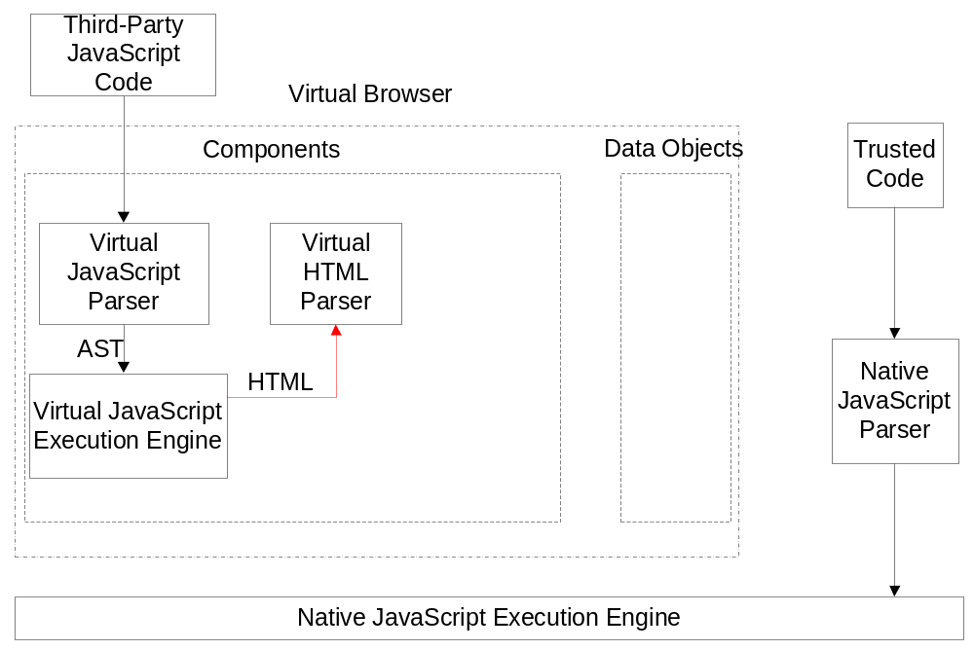
System Architecture

Slide 17
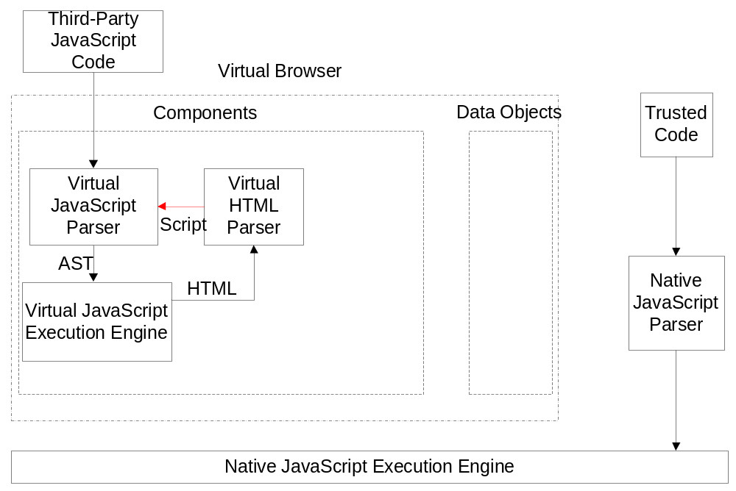
System Architecture

Slide 18
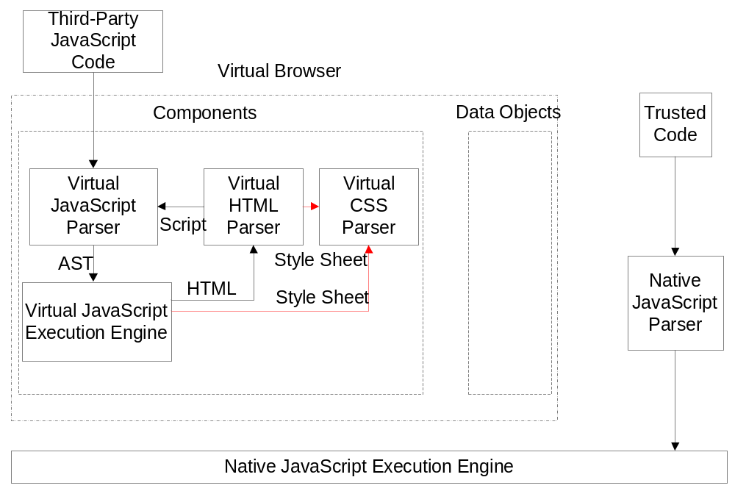
System Architecture

Slide 19
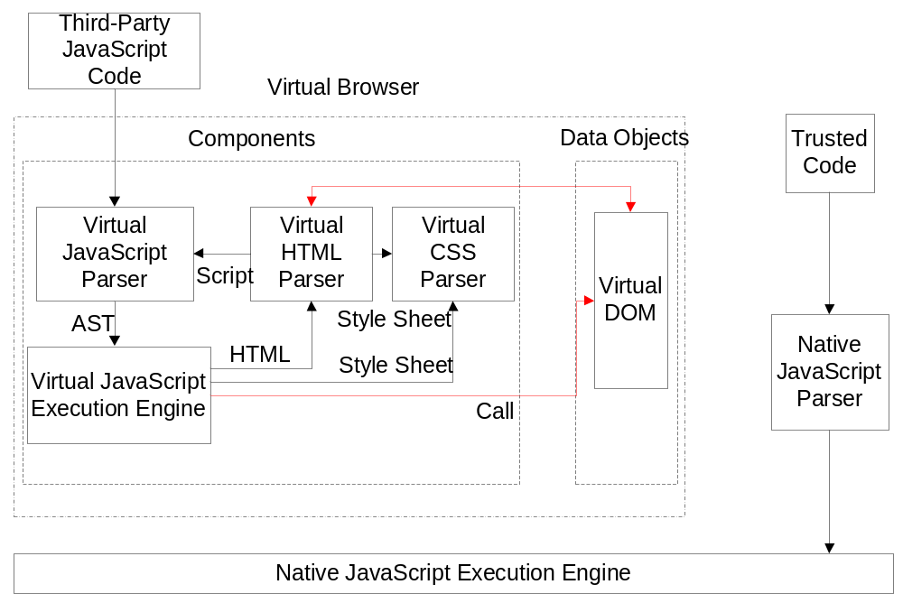
System Architecture

Slide 20
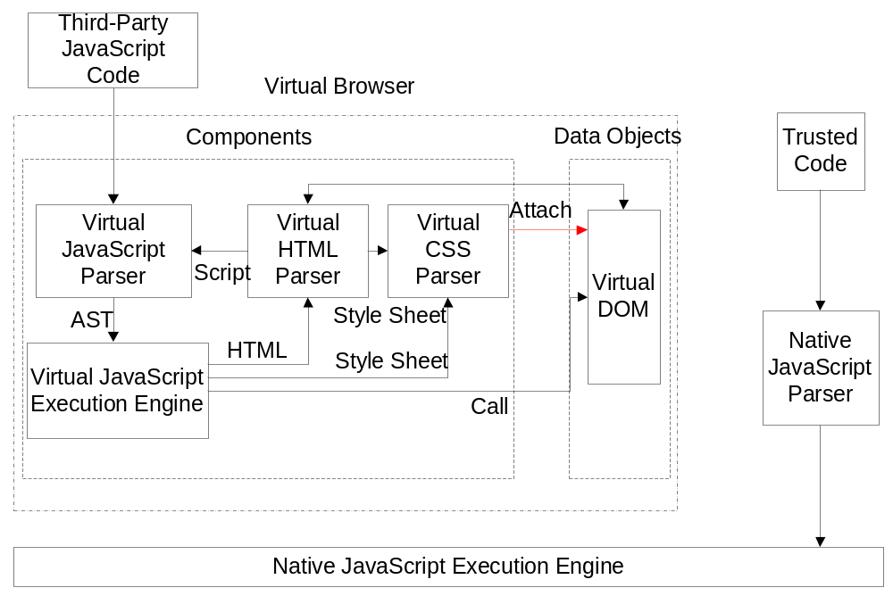
System Architecture

Slide 21
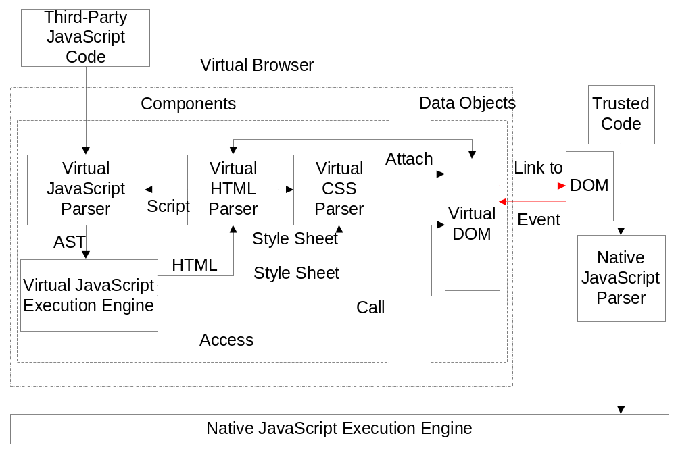
System Architecture

Slide 22
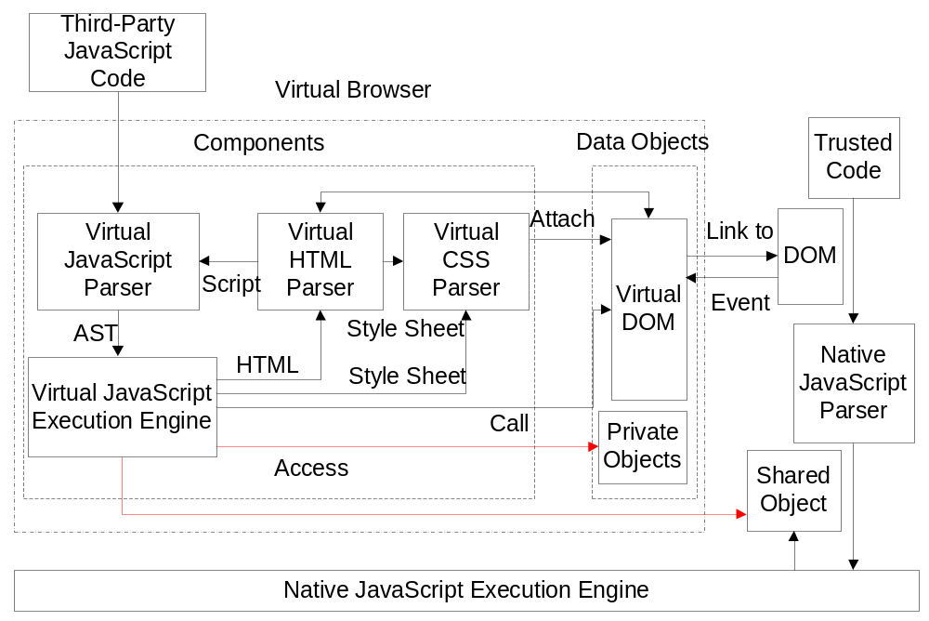
System Architecture

Slide 23
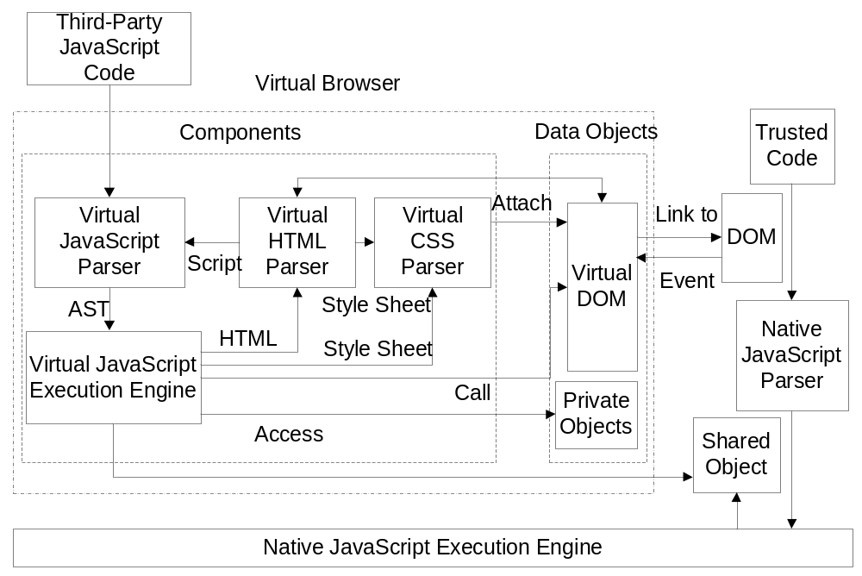
System Architecture
All written in JavaScript: supported by all browsers

Slide 24
System Architecture
Virtualization: Robust to drive-by-download

Slide 25
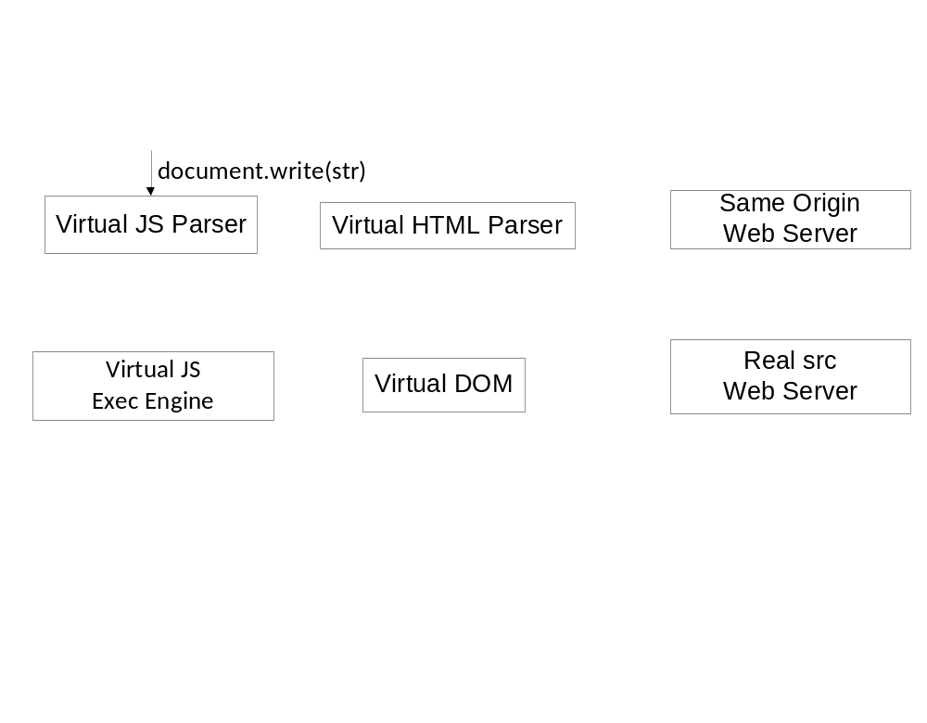
An Example
How to support dynamic features?

Slide 26
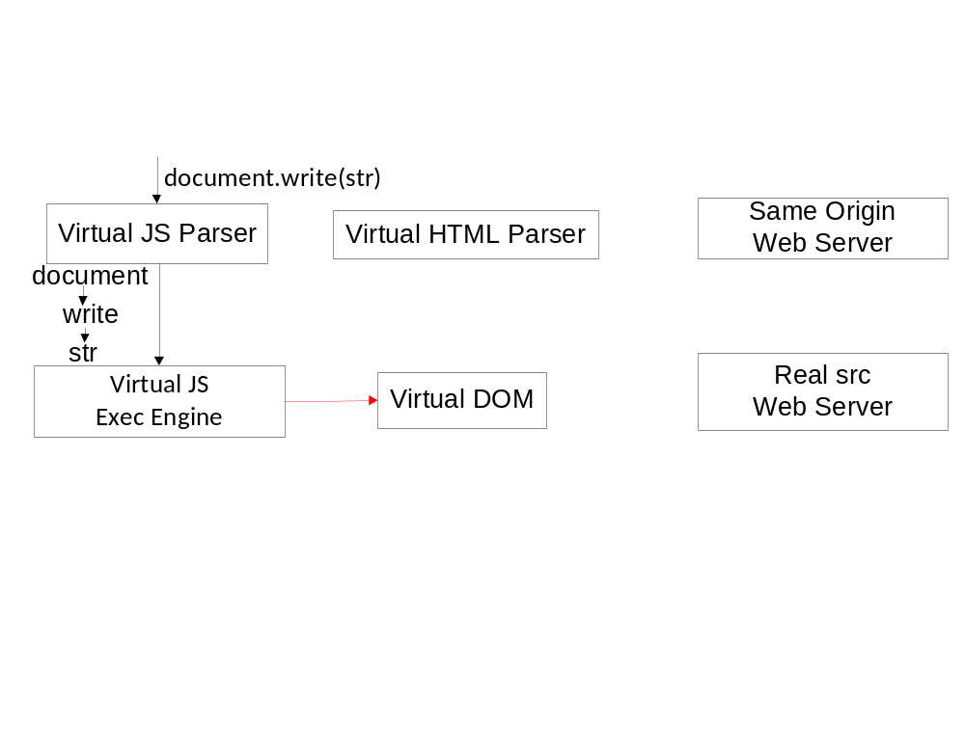
An Example

Slide 27
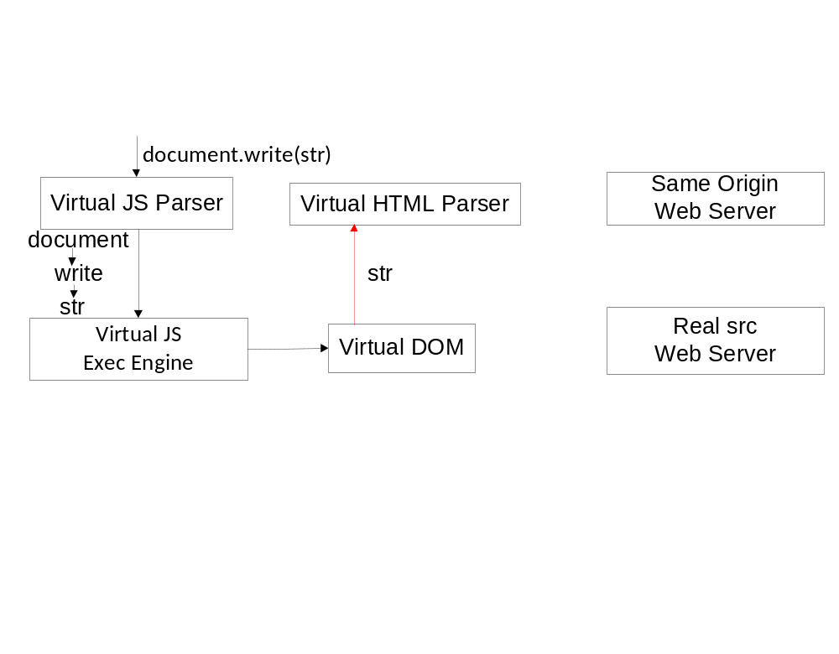
An Example

Slide 28
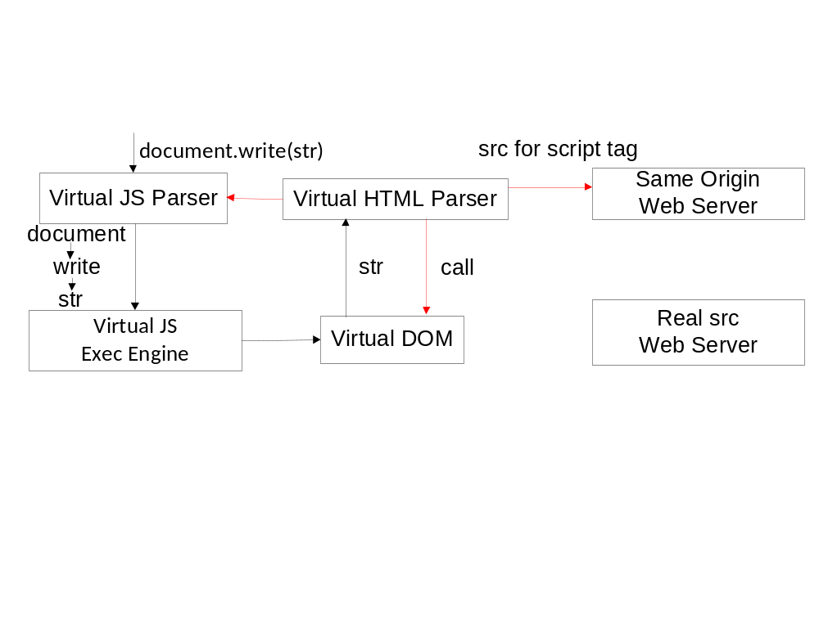
An Example

Slide 29
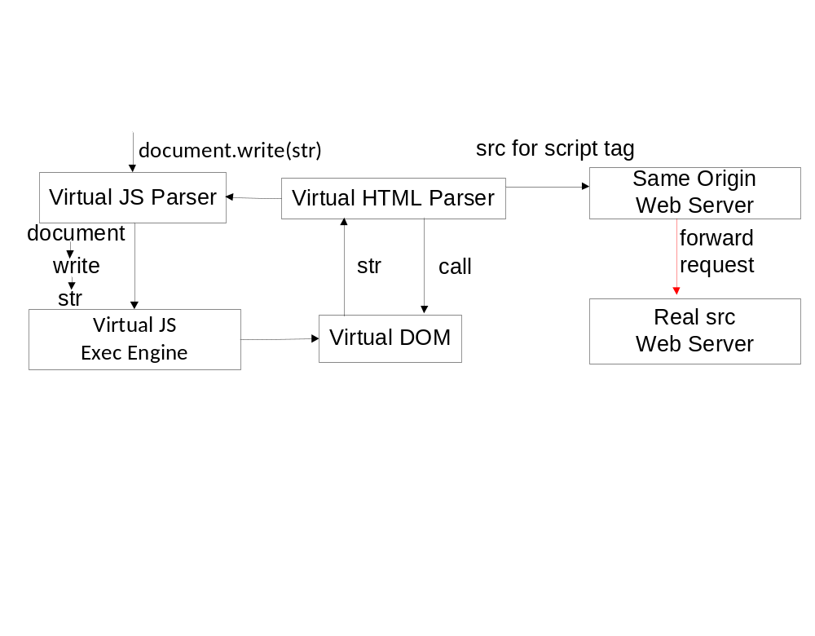
An Example

Slide 30
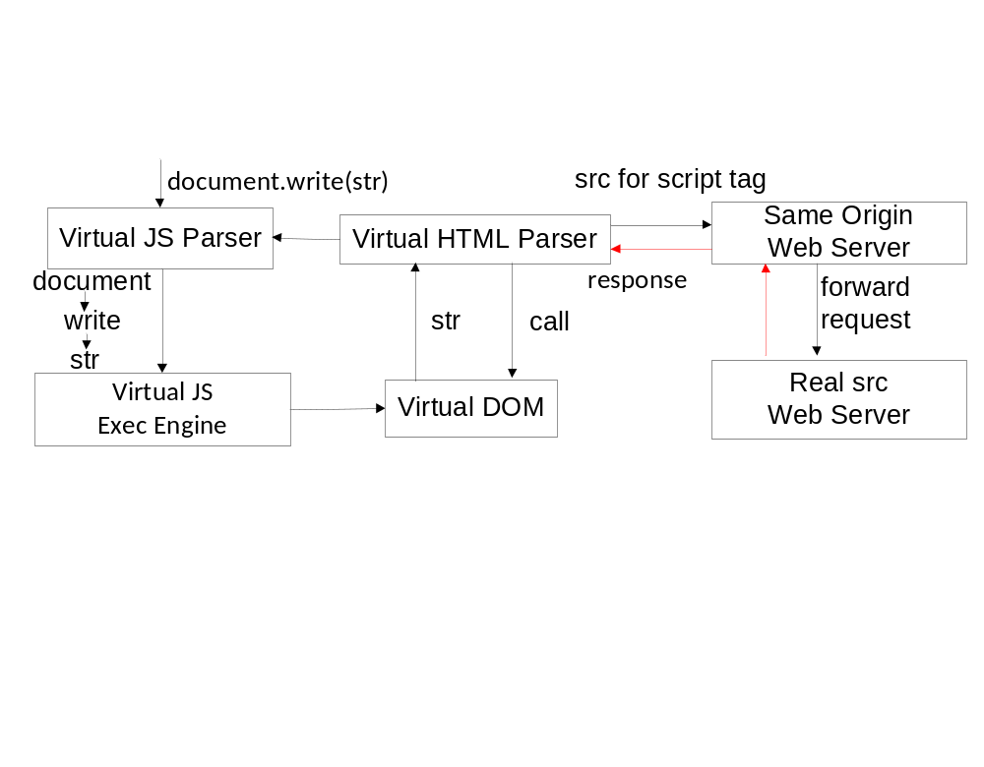
An Example

Slide 31
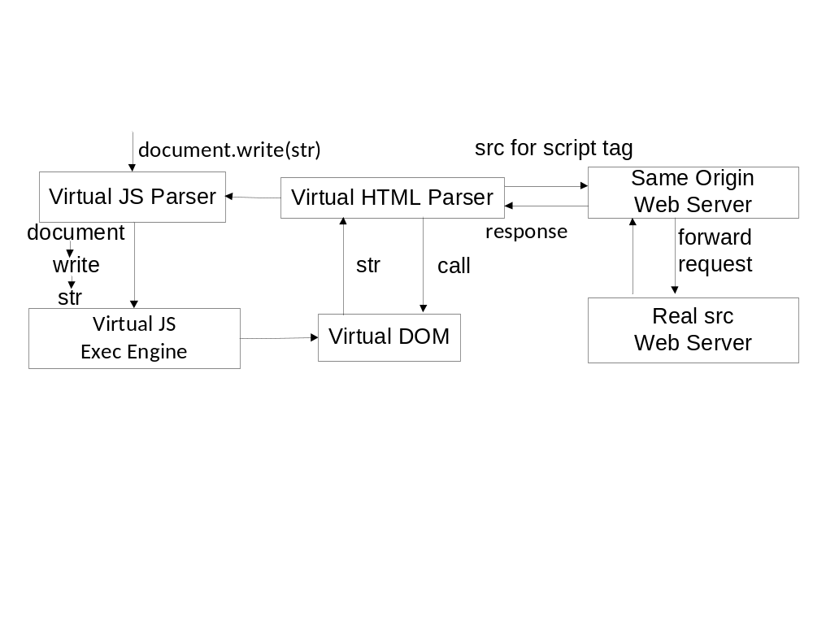
An Example

Slide 32
Outline
Introduction
Related Work
Design
Security Analysis
Evaluation
Conclusions

Slide 33
Security Analysis
Isolating third-party JavaScript through Avoidance
  Cutting off Outflows of Virtual Browser
  Cutting off Inflows of Virtual Browser
Communication between third-party JavaScript and trusted JavaScript
  Data Security
  Script Security
  Securing Data Flows in Virtual Browser

Slide 34
Isolation through Avoidance
Cutting off Outflows of Virtual Browser
  We ensure third-party codes are trapped inside Virtual Browser.
  An assumption: Any JavaScript code has to be parsed in the native JavaScript parsers before it can be executed in native browser.
    (1) Look up Manuals
    (2) Call Graph Analysis

Slide 35
Cutting off Outflows
Cutting off Outflows of Virtual JavaScript Engine
  Only eval and new Function will cause native parsing.
  Call graph analysis also shows that.
Cutting off Outflows of Virtual HTML and CSS parser :Similar
So we avoid using eval and new Function in Virtual Browser source codes.

Slide 36
Cutting of Inflows
Anonymous Object Encapsulation
  (function(){
  this.evaluate= function () {
  codes
  }
  other codes
  })
  ();

Slide 37
Communication through Redirection
Data Security
  General Data Security
    Mirrored Object
    Access Control
      Such as Object Views
function String(s) {
s = arguments.length ? "" + s : "";
if (this instanceof String){
this.value = s;
return this;
}
return s;
}

Slide 38
Communication through Redirection
Data Security
  Script Security
    Determined Scripts
      Scripts that need immediate execution. (evaluate it)
      Scripts that need delayed execution. (such as setTimeout)
        Pseudo-function Pointer
setTimeout(function(){
execute(parsed node, exe context)
}
,100)

Slide 39
Communication through Redirection
Data Security
  Script Security
    Undetermined Script
      Privilege escalation may happen.
      We are on par with existing solutions.
      As shown by Finifter et al., we need to adopt narrow interface.

Slide 40
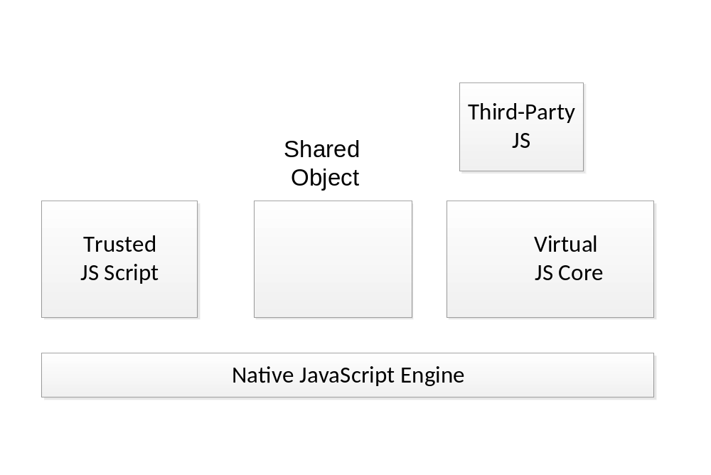
Securing Data Flows

Slide 41
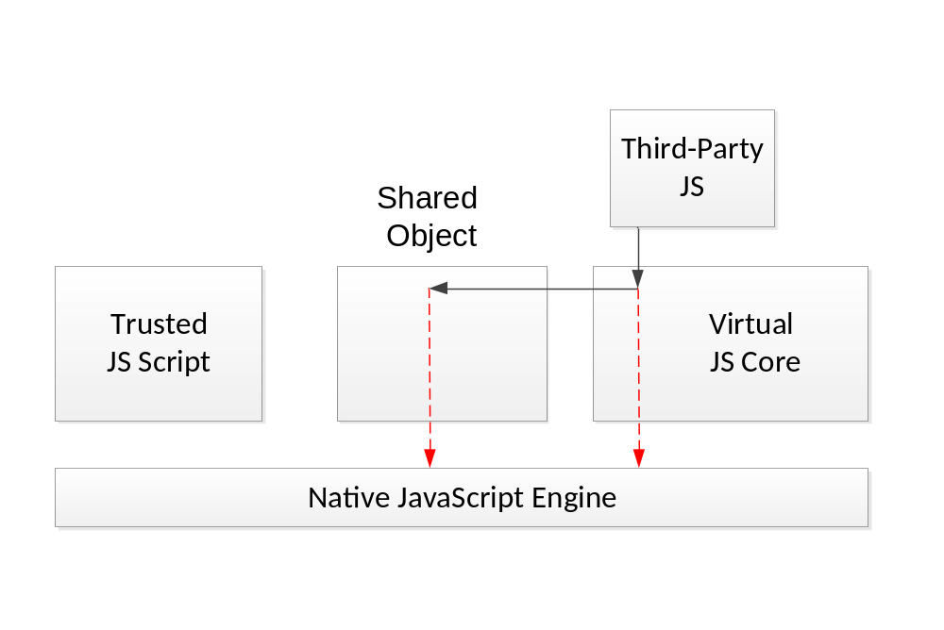
Securing Data Flows
Redirect them back to virtual engine
document.write
eval

Slide 42
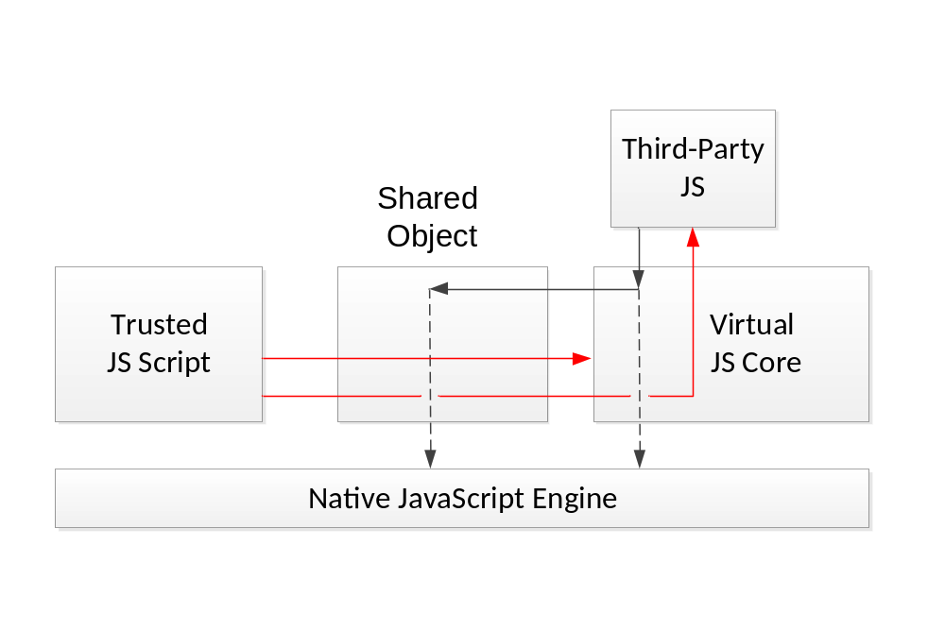
Securing Data Flows
Prevented by encapsulation

Slide 43
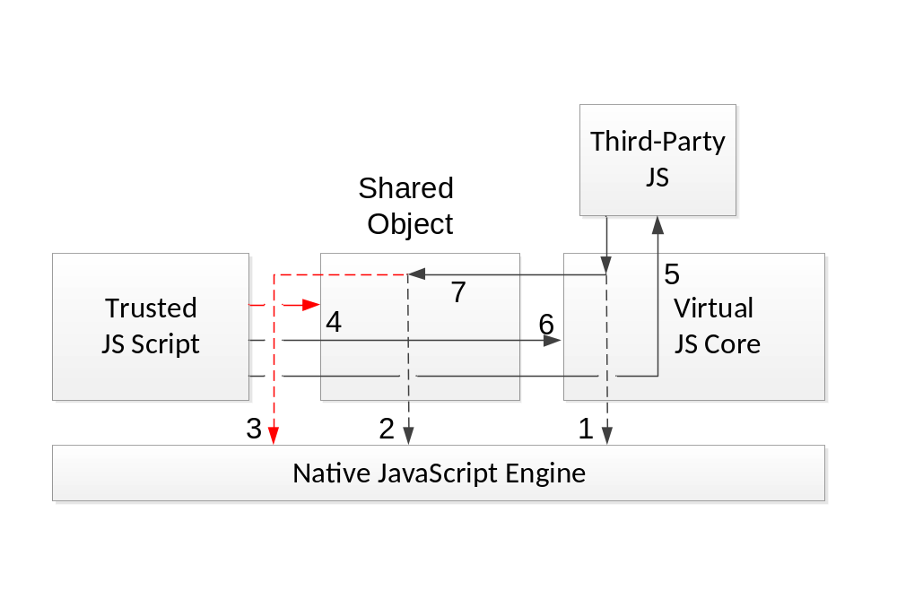
Securing Data Flows
Privilege escalation: we are on par with existing solutions.

Slide 44
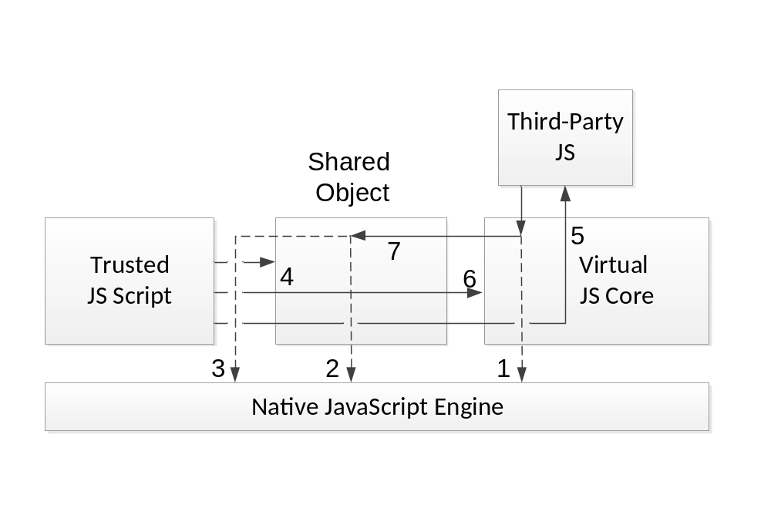
Securing Data Flows

Slide 45
Similar analysis can be applied to virtual CSS parser and HTML parser.

Slide 46
Outline
Introduction
Related Work
Design
Security Analysis
Evaluation
Conclusions

Slide 47
Evaluation
Performance Evaluation
  Speed
  Memory Usage
  Parsing Latency
Browser Quirk Compatibility
Robustness to Unknown JavaScript Vulnerability
Completeness of Implementation

Slide 48
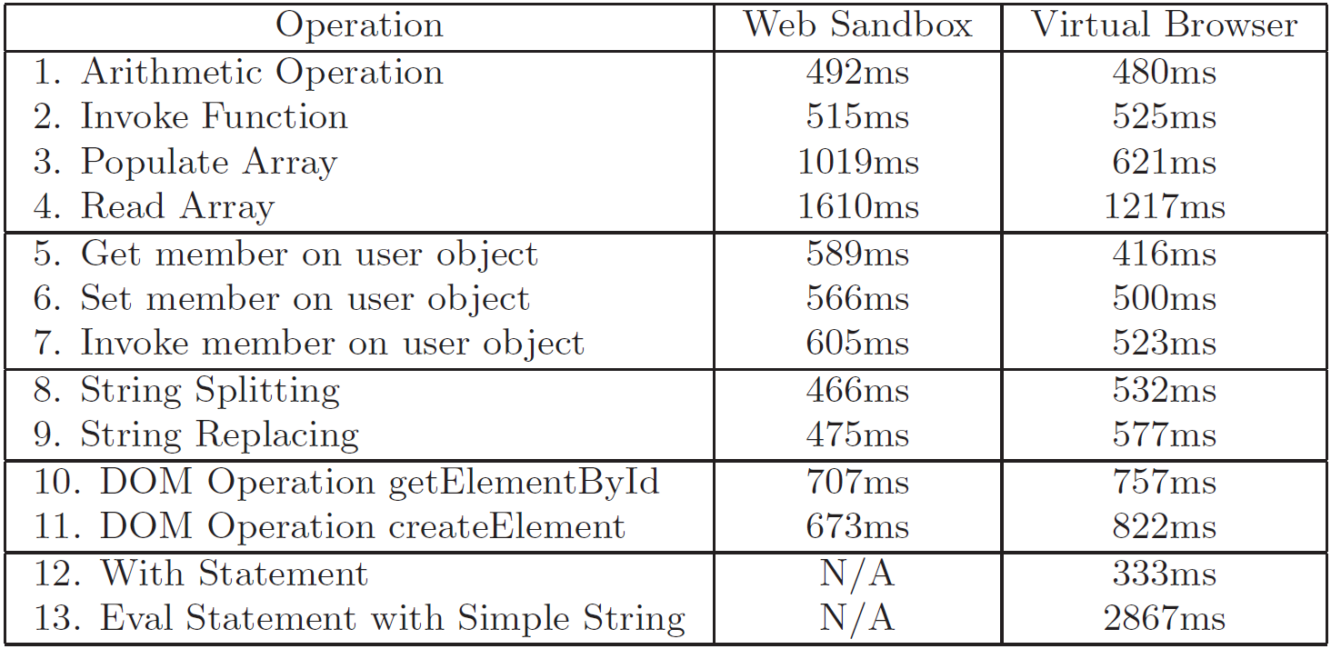
Performance
On par with Web Sandbox.
Micro-benchmark

Slide 49
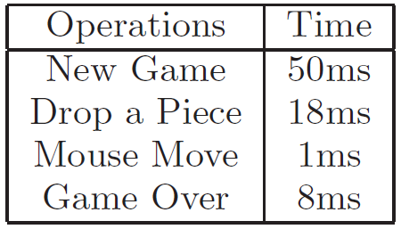
Performance
Macro-benchmark (Game: Connect Four)

Slide 50
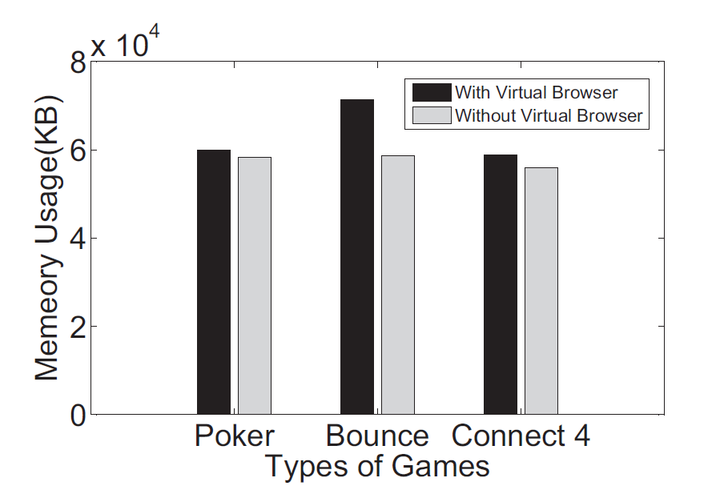
Memory Usage

Slide 51
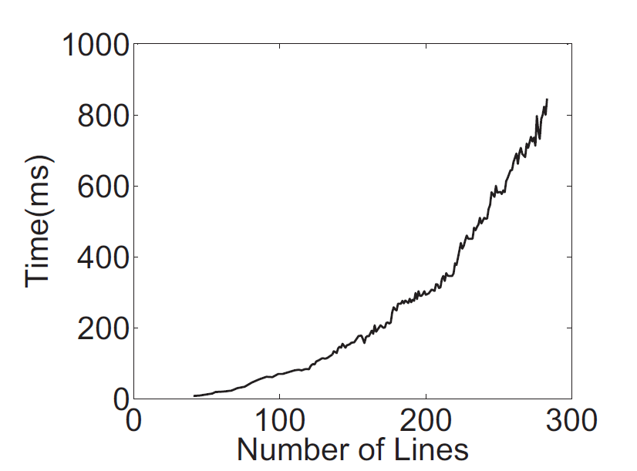
Parsing Latency (JavaScript)

Slide 52
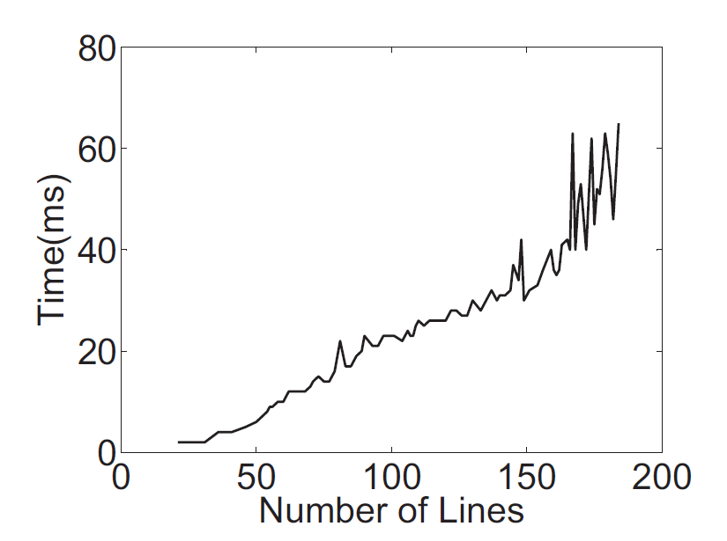
Parsing Latency (HTML)

Slide 53
Evaluation
Robust to Browser Quirk
  Robust to 113 browser quirks in XSS cheat sheet
Robust to Unknown JavaScript Vulnerabilities
  Robust to 14 JavaScript engine vulnerabilities in CVE
Completeness of Implementation
  Pass 96% test cases of ECMA-262 Edition 1 from Mozilla

Slide 54
Discussion
Speed – Slow
  Yes. However, latency is acceptable.
  JavaScript engine is becoming faster and faster
How do we deal with vulnerability of virtual engine?
  Type safe language
  Virtual engine adds another layer that make sure security. (Similar to Virtual Machine)

Slide 55
Outline
Introduction
Related Work
Design
Security Analysis
Evaluation
Conclusions

Slide 56
Conclusion
We build Virtual Browser, a virtualized browser upon native browsers.
We are
  Robust to browser quirks.
  Robust to drive-by-download.
  Supported by all current browsers.
  Support dynamic JavaScript features
  And Slow – Yes, we are ☺

Slide 57
Thanks ☺
Any Questions?

